Slide 1
Chengdu AV-EV Engineering Center: Battery Management System Development Final Report Simcenter Engineering and Consulting, 05/25/2020
June 2020
Realize Innovation

Slide 2
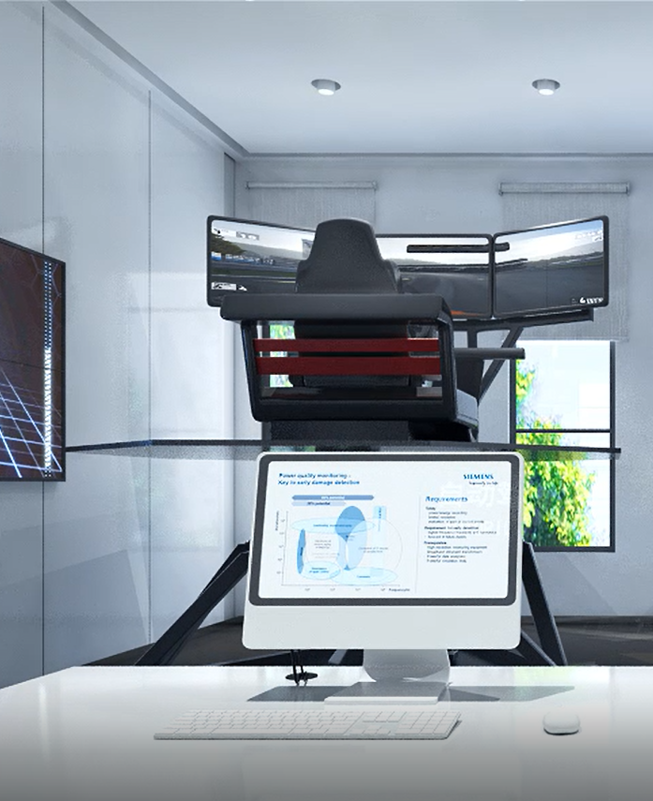
Document Outline
1. Project overview
2. Project Execution Plan
3. Project Schedule
4. Work Package 3.1: System Engineering
5. Work Package 3.2: BMS Development Stage 1
6. Work Package 3.3: BMS Development Stage 2
7. Work Package 3.4: BMS Development Stage 3
8. Summary of Project

Slide 3
1. Project Overview Project Context and Target
Setup end-to-end workflow to demonstrate the development of Battery Management System (BMS) algorithms and software on a virtual battery pack
Process orchestration using Polarion
Requirements and Test Cases organization and management using Polarion
Battery cell and pack models implemented in Simcenter Amesim to test and verify the BMS algorithm and software
BMS algorithms implemented as control logic in MATLAB/Simulink and its verification testing executed using open loop and MIL simulation
Embedded application C-code generated from the algorithm model using auto code generation technology and SIL based tests executed to verify functionality.
Implement the developed BMS algorithm software on a Rapid Prototyping Electronic Control Unit (RPC)
This BMS controller can be used on the HIL bench planned for the second phase of the BMS demonstrator.

Slide 4
2. Project Execution Plan Siemens Solution
Goal: To demonstrate the overall development process of battery management system starting from system requirements gathering, test cases establishment to build Simulink model, open loop testing, MIL and implementation to RPC.
The work will be executed in the following Work Packages (WP).
WP3.1: System Engineering – Define BMS system architecture, define features of BMS, generate system requirements for each feature, generate test cases for each feature. Use Polarion to track all system engineering work.
WP2: Battery Development Stage 1 – Develop Amesim model for representative battery model. Develop SOC, mode control and contactor control: develop control logic for the three features in Simulink and conduct open loop and MIL testing. Acquire RPC.
WP3: Battery Development Stage 2 – Develop VIT Monitoring, thermal control, SOP and SOH: develop control logic for the four features in Simulink and conduct open loop testing and MIL Setup RPC, autocode generation and testing.
WP4: Battery Development Stage 3 – Develop cell balancing and open loop testing RPC: develop control logic for cell balancing in Simulink and conduct open loop testing and MIL Conduct open loop testing of RPC with desktop testing model data.
WP5: Documentation and Presentation – document BMS work and support BMS hardware demonstrator in Chengdu AV/EV engineering center
WP 3.1: System Engineering
WP3.2: BMS Development Stage 1
WP3.3: BMS Development Stage 2
WP3.4: BMS Development Stage 3
WP3.5: Documentation and Presentation

Slide 5
3. Project Schedule

Slide 6
Work Package 3.1: System Engineering

Slide 7
WP3.1 Recap: System Engineering System architecture, requirements, test cases, Polarion setup
Target: Gather requirements and information on battery management system (BMS) and establish test cases for validating BMS
Task Description:
Literature review on BMS system and establish architecture of overall BMS
Develop overall BMS architecture that reflects all BMS functionalities
Develop preliminary requirements for BMS
RPU information gathering and requirements generation
Generate test cases that can be used to validate requirements of BMS
Work Package Output:
Polarion setup for system engineering
System requirements established in Polarion
Test cases established in Polarion

Slide 8
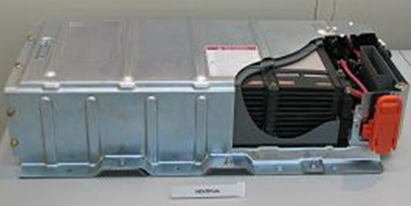
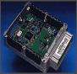
BMS System Closed Loop Overview
Controller
Battery Pack (Plant)
ECU
Micro Processor
Embedded Software
I/O Hardware
Vehicle Commands
actuators
sensor
Objectives: Control system is required to
Monitor pack current, voltages, temperatures
Control battery temperature to desired range
Determine state of charge and available energy (fuel gauge), state of health and power limits
Keep cells within safe operating ranges to prevent damage and abuse and prolong the cell life
Fulfill functional requirements of the application in which it is used

Slide 9
BMS System Architecture
Software
Battery Management System Layer
Low Voltage Battery Control (cell balancing)
Battery V-I-T Monitoring and Diagnostics
State and Mode Control
Contactor Control
Thermal controller
SOC
SOP
SOH
Virtual I/O Layer
Virtual RTOS Layer
I/O Layer
RTOS Layer
Low-Level Drivers
Low-Level Drivers
Hardware Layer

Slide 10
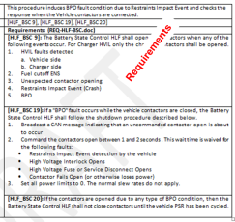
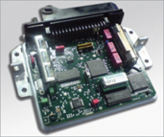

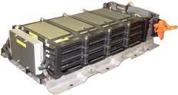
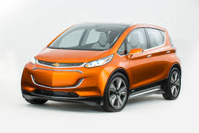
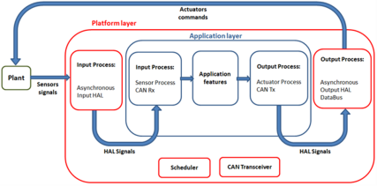
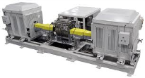
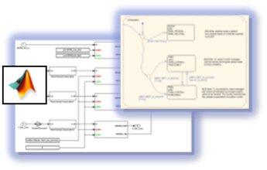
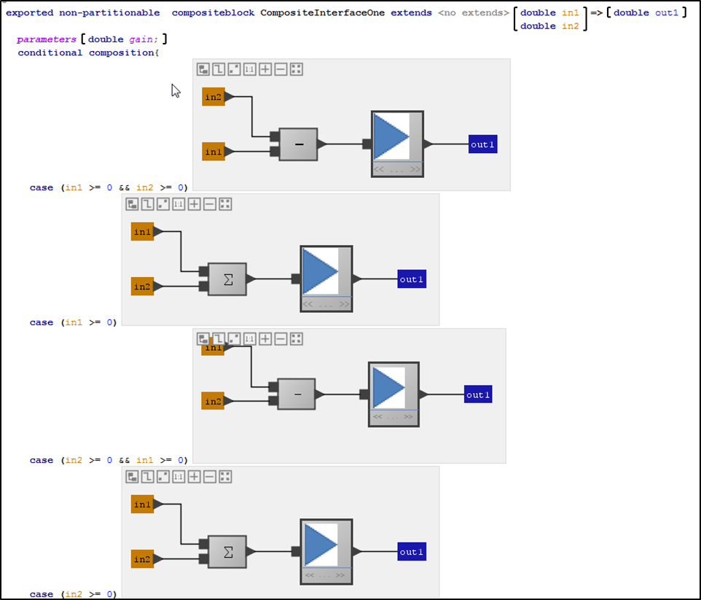

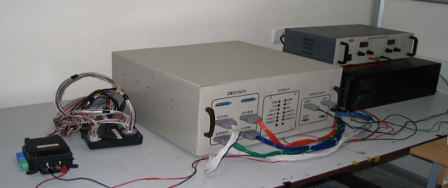
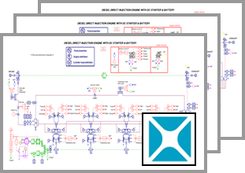
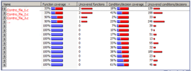
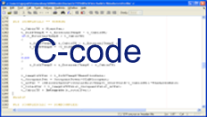

MBSE Development Process for BMS
More effort spent upstream to reduce later re-work
ECU Requirements and Change Requests
Requirements analysis
Vehicle integration & testing
Architecture Partitioning
Algorithm Specification development
Powertrain system testing
Style Guides, Blocksets and Style Checkers
MIL
HIL
ESD
Model based algorithm testing
(MIL)
Open-Loop & Closed-Loop Testing; Automated Testing
ECU System integration bench testing
SIL
Different levels of plant models to test different control features
Repeat Open-Loop & Closed-Loop Testing; Automated Testing
Integration with legacy C-code for application build
Coverage based Test Quality enhancements
Code-generation

Slide 11
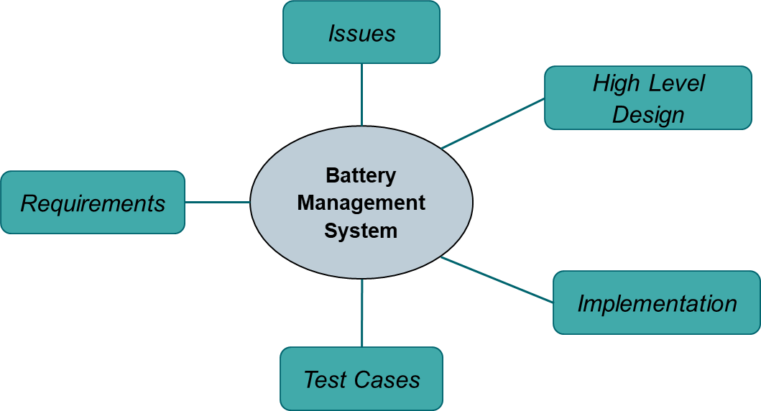

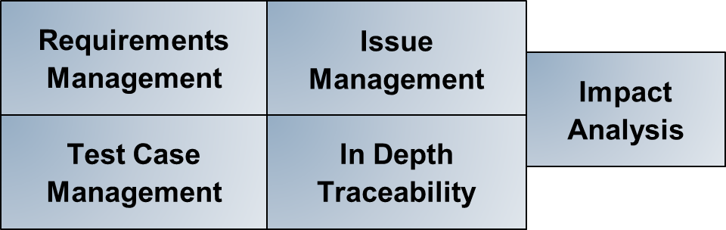
Managing the Software Development Artifacts Polarion for BMS Development
Siemens utilized Polarion ALM during the development of the Battery Management System
Utilizing Polarion ALM allowed software engineers the ability to efficiently manage software development artifacts, maintain detailed traceability between artifacts, and quickly conduct impact analysis across the application.
Development artifacts stored in Polarion

Slide 12
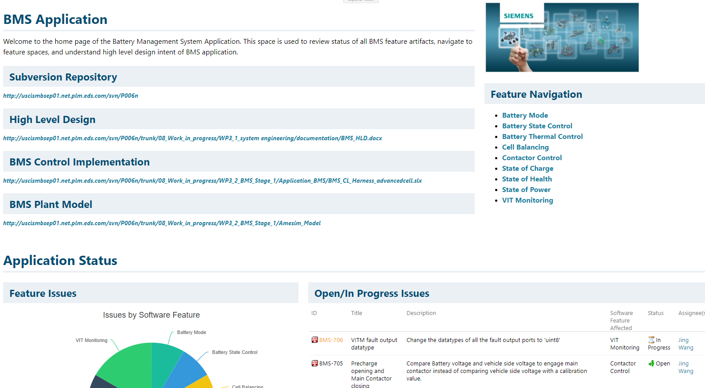
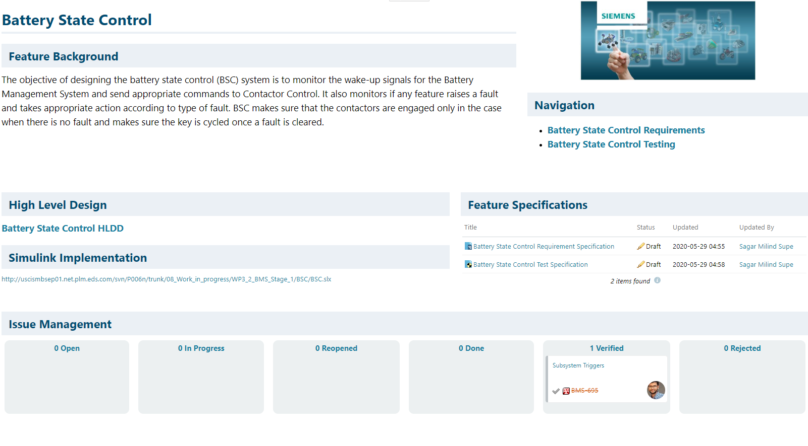
Polarion for BMS Polarion Architecture
The Battery Management System Polarion project is configured with unique areas for the BMS Application, all of the software features within the BMS Application, and Issue Management.
This structure allows feature engineers the ability to work on their respective feature, while the application engineer has insight to all of the feature development work.
Each feature software area consists of a feature homepage, feature requirements, and feature testing page.
.

Slide 13
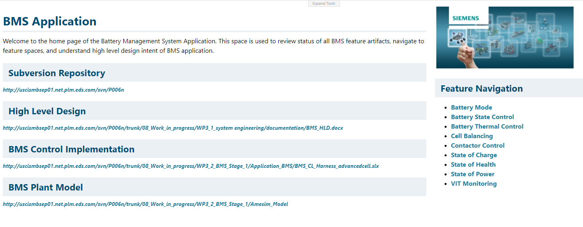
Polarion for BMS BMS Application Level Page – Overview/Navigation
Navigation to Subversion Repository
High Level Design Document
Navigation to each BMS Software Feature Portal
Simulink and Amesim Application Control/Plant Models

Slide 14
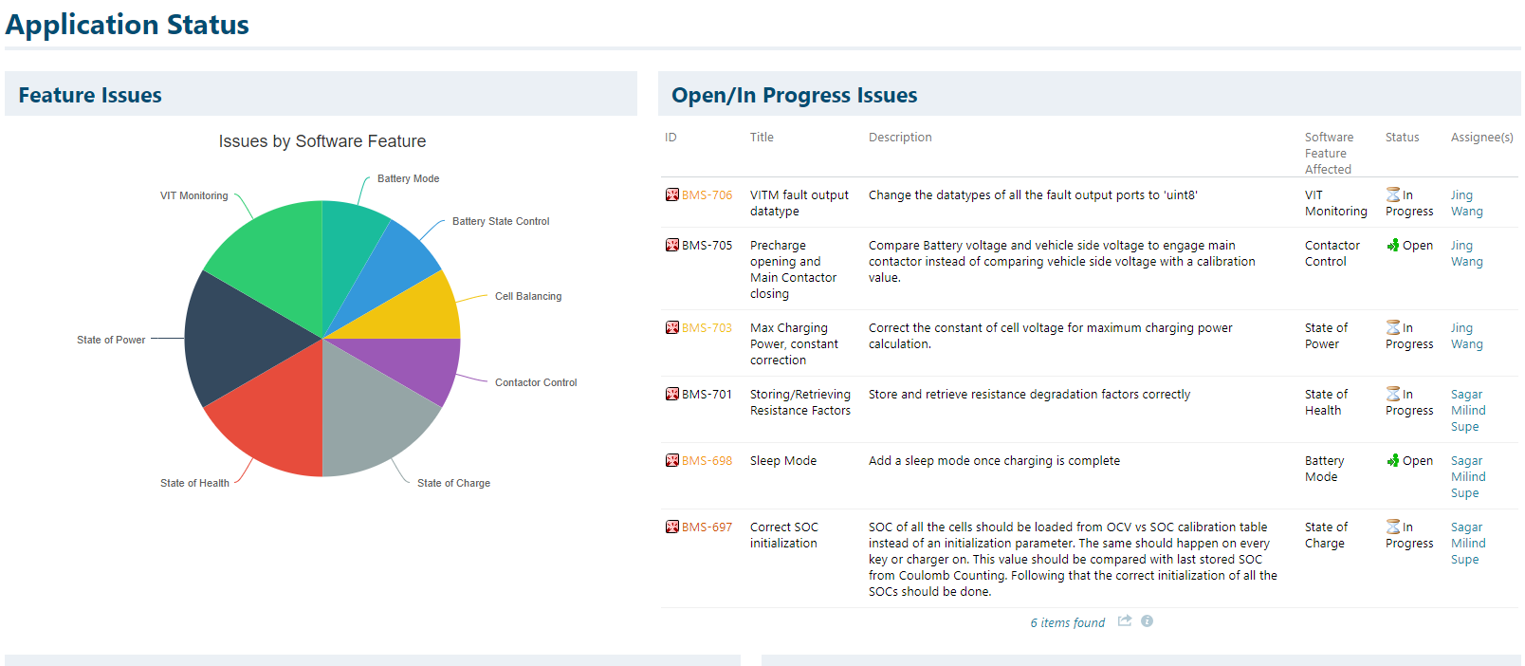
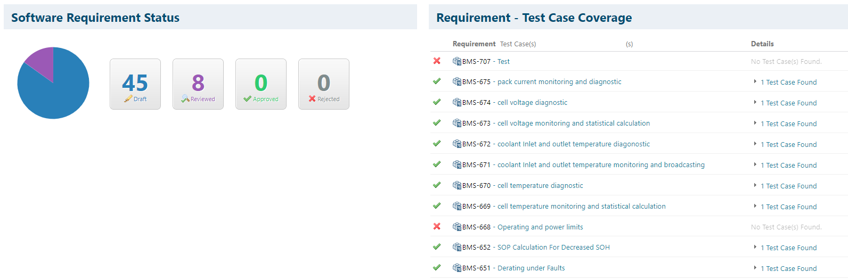
Polarion for BMS BMS Application Level Page – Issues/Requirements/Test Case Status
Status on development issues broken down by SW Feature
Open/In Progress Issues
Requirement Status
(For all Feature Reqs)
Report showing Requirement-Test Case Coverage

Slide 15
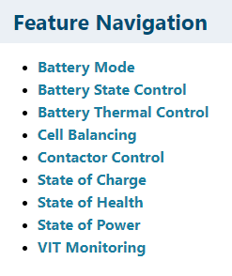
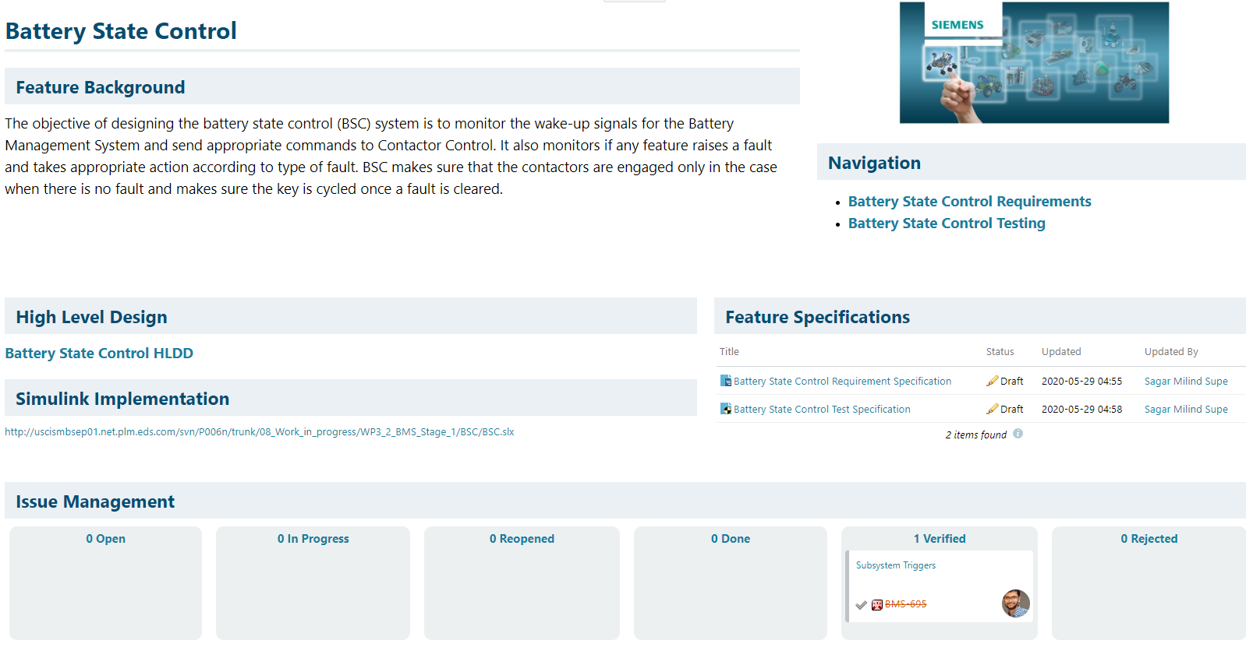
Polarion for BMS Feature Level Pages
Within the Polarion environment, each feature owner has their own space to manage the development of their respective software feature
Within this space, feature owners can do the following:
Document/Link high level design information
Create and manage software requirements
Create and manage software test cases
Establish traceability between software requirements and test cases
Create and manage issues related to the software feature
Conduct impact analysis on work items
Automated reporting of work item status’, test run reports, etc.

Slide 16
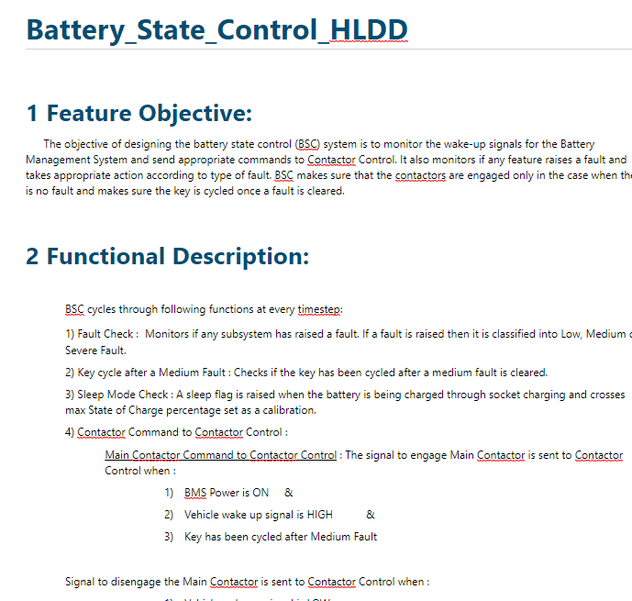
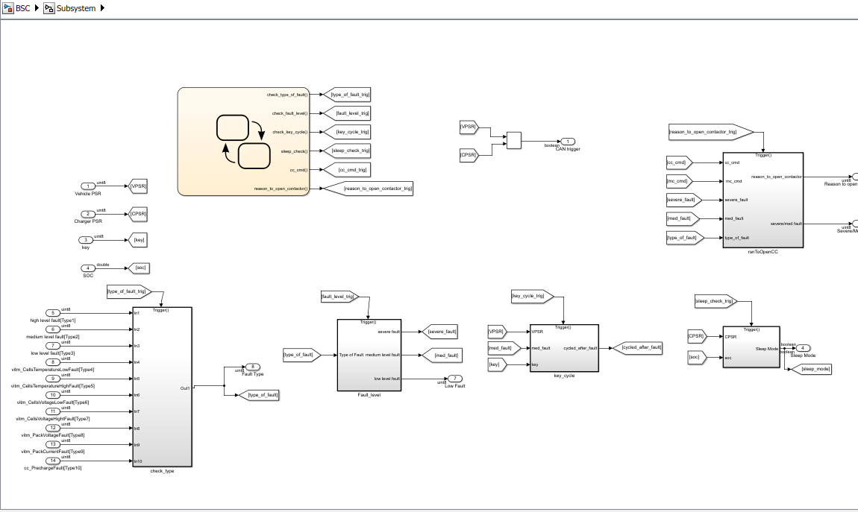
Polarion for BMS Feature Level - Homepage
High Level Design Document
Simulink Implementation
Issues related to Feature and their status (KANBAN)

Slide 17
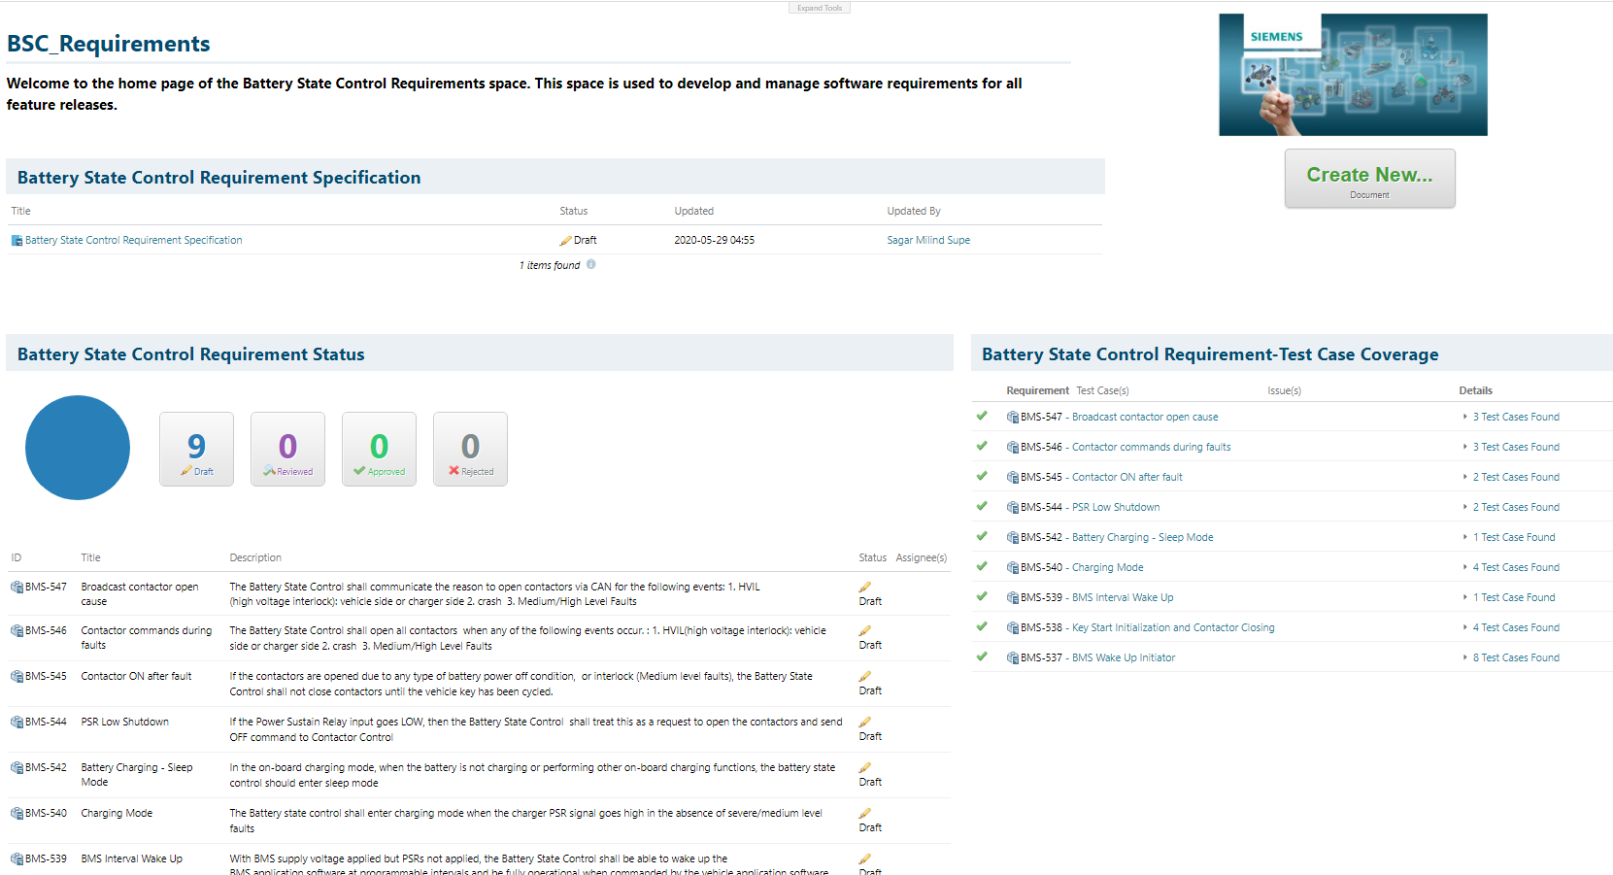
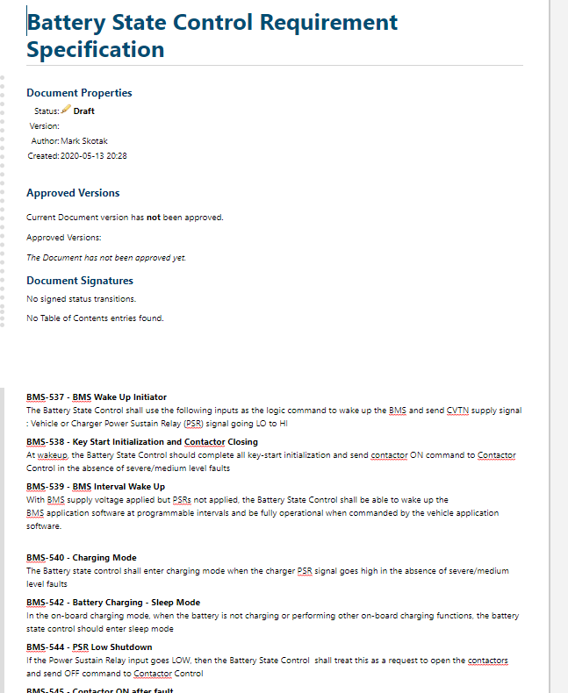
Polarion for BMS Feature Level – Requirements Page
Requirement Specification
Feature Requirement Status
Requirement – Test Case Coverage

Slide 18
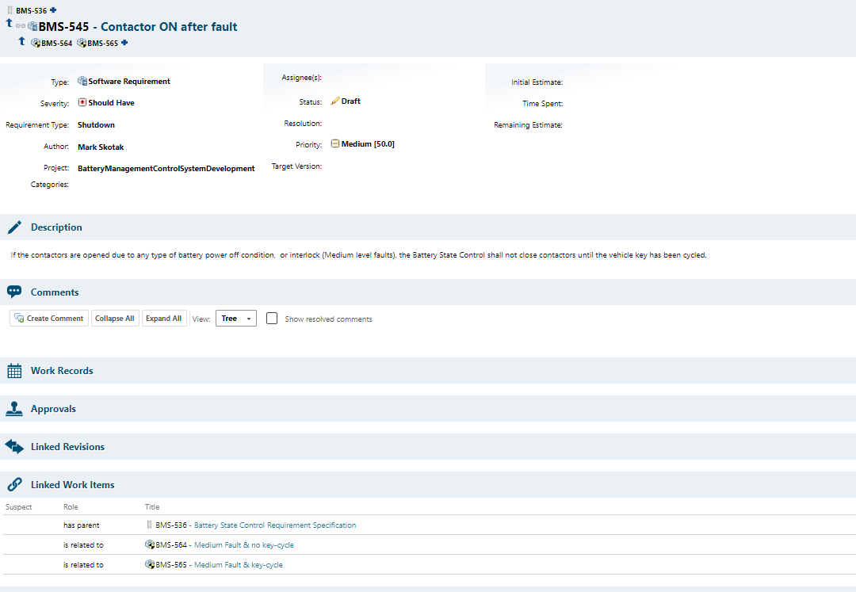
Polarion for BMS Feature Level – Requirements
Feature requirements are managed through Requirement Specification documents with each requirement being a unique software requirement work item
Custom attributes created to query and filter on software requirements
Traceability established between requirements and test cases. Facilitates easy, fast, impact analysis.
Requirement Attributes
Linked Work Items (Traceability to other requirements and test cases)

Slide 19
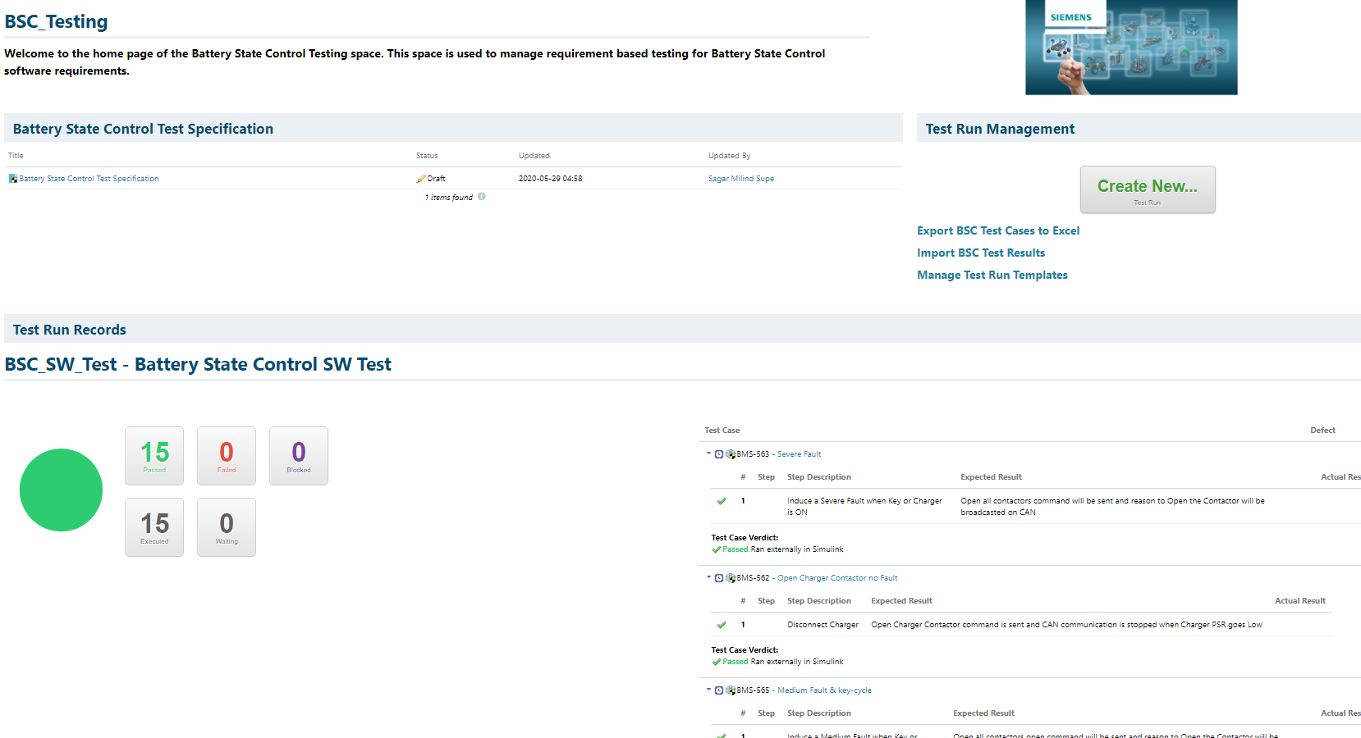
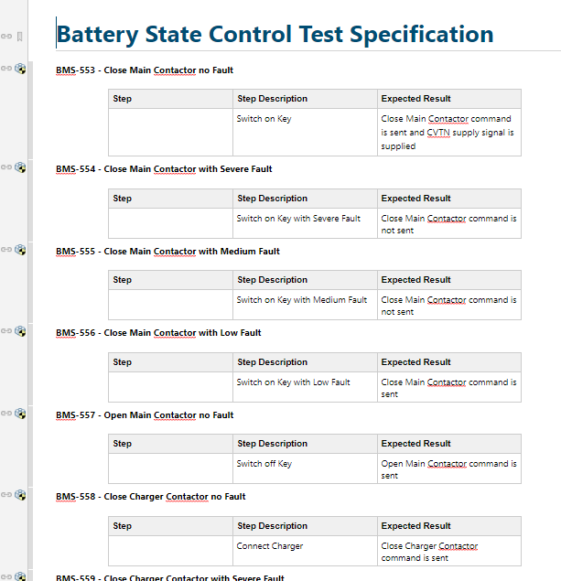
Polarion for BMS Feature Level – Testing
Test Specification
Import/Export Test Runs/Results
Test Status/Records

Slide 20
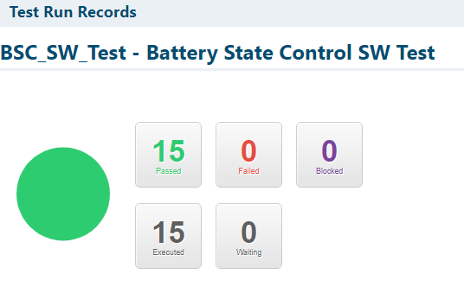
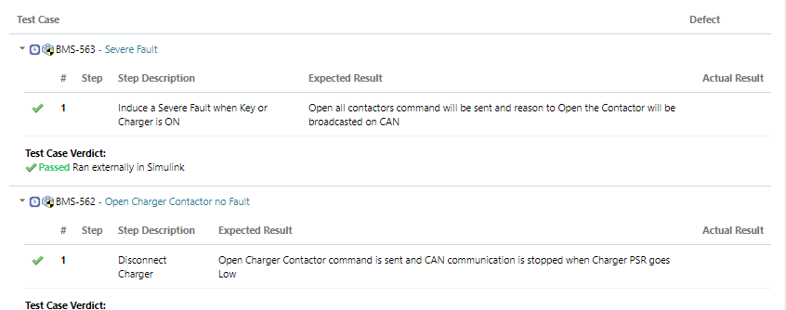
Polarion for BMS Feature Level – Testing
Feature owners can create and manage test cases within Polarion
Test cases can be linked to the requirements that they are verifying to create coverage on requirements
Test results imported from external testing environment
Dashboards populated to show coverage metrics, test case status, and test results
History maintained on all test run records
Test Run Dashboard
Detailed Results

Slide 21
Work Package 3.2: BMS Development Stage 1– Battery Pack Modeling, Contactor Control, Battery Mode control and SOC

Slide 22
WP3.2 Recap : BMS Development Stage 1
Target: Develop key features of BMS system (contactor control, SOC, Mode) and acquire the proper RPU module for embedded code testing
Task Description
Develop proper architectures for the BMS subsystems: contactor control, SOC, Mode
Build Simulink blocks for each BMS subsystem and conduct open loop testing
Develop Amesim battery and electric vehicle model, and integrating Amesim model with Simulink BMS system
Open Loop/ Closed loop testing to validate the functionality of each subsystem
Outputs:
Simulink dummy models with properly defined subsystems and their inputs/outputs
Simulink model established for each BMS subsystem
Open loop testing finished for each Simulink model
Amesim battery model built and calibrated, and connected with existing electric vehicle demo model
Integration between Amesim model and BMS system completed in Simulink environment
Open/Closed loop test case results generated and linked to Polarion requirements

Slide 23
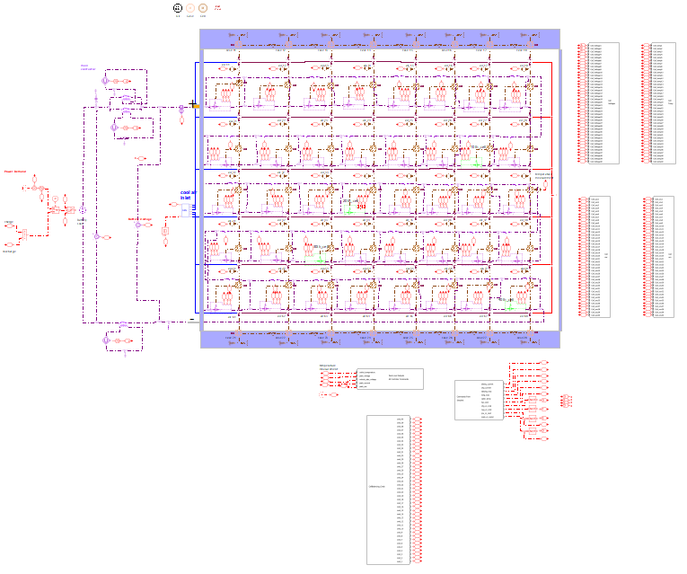
Battery Pack Model Development in Amesim
In coming slides, a brief description of the Amesim Battery Model is presented
Power Cycle Input or Current Cycle Input
Amesim Simulink Communication
Contactor Modelling

Slide 24
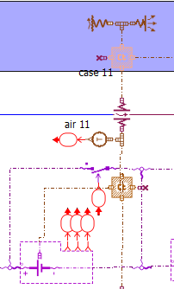
Battery Pack Model Development in Amesim
The Battery is made up 40 cells. Each cell is an instance of NMC HP pre-calibrated cell present in Amesim.
Each cell has OCV dependent on SOC, charging and discharging internal resistance dependent on temperature and SOC.
Each cell has an option for static aging for capacity and resistance to check features related to estimation of degraded capacity and resistance.
Each cell has a thermal model connected to it.
The thermal and electrical properties are in accordance with the pre-calibrated data of NMC HP cell.
Inlet of air is present at one end of the battery to control the temperature of the battery.
All the cells are connected in series and are placed in a polypropylene case.
Thermal Exchange between battery case and outside air
Thermal Mass of case
Thermal Exchange between cell and air inside case
Cell Balancing Switch
Cell Thermal Mass
NMC HP cell

Slide 25
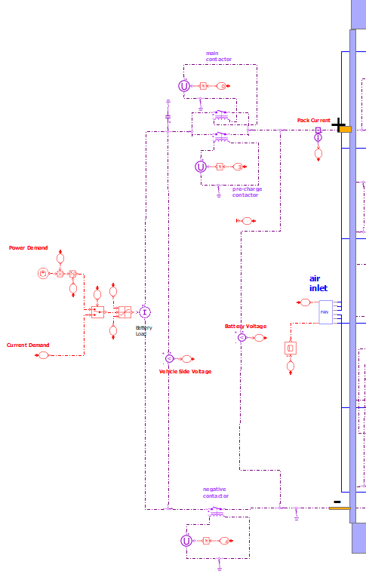
Battery Pack Model Development in Amesim
Contactor Mechanism is modeled outside the battery as shown.
A capacitor is connected on the vehicle side to imitate capacitance which might be present in motor drivers.
Main Contactor (Same Contactor is used as Charger Contactor when Charger Contactor signal is received)
Vehicle side Capacitance
Pre-Charge Contactor
Input Power or Current cycle
Air Inlet
Negative Contactor

Slide 26
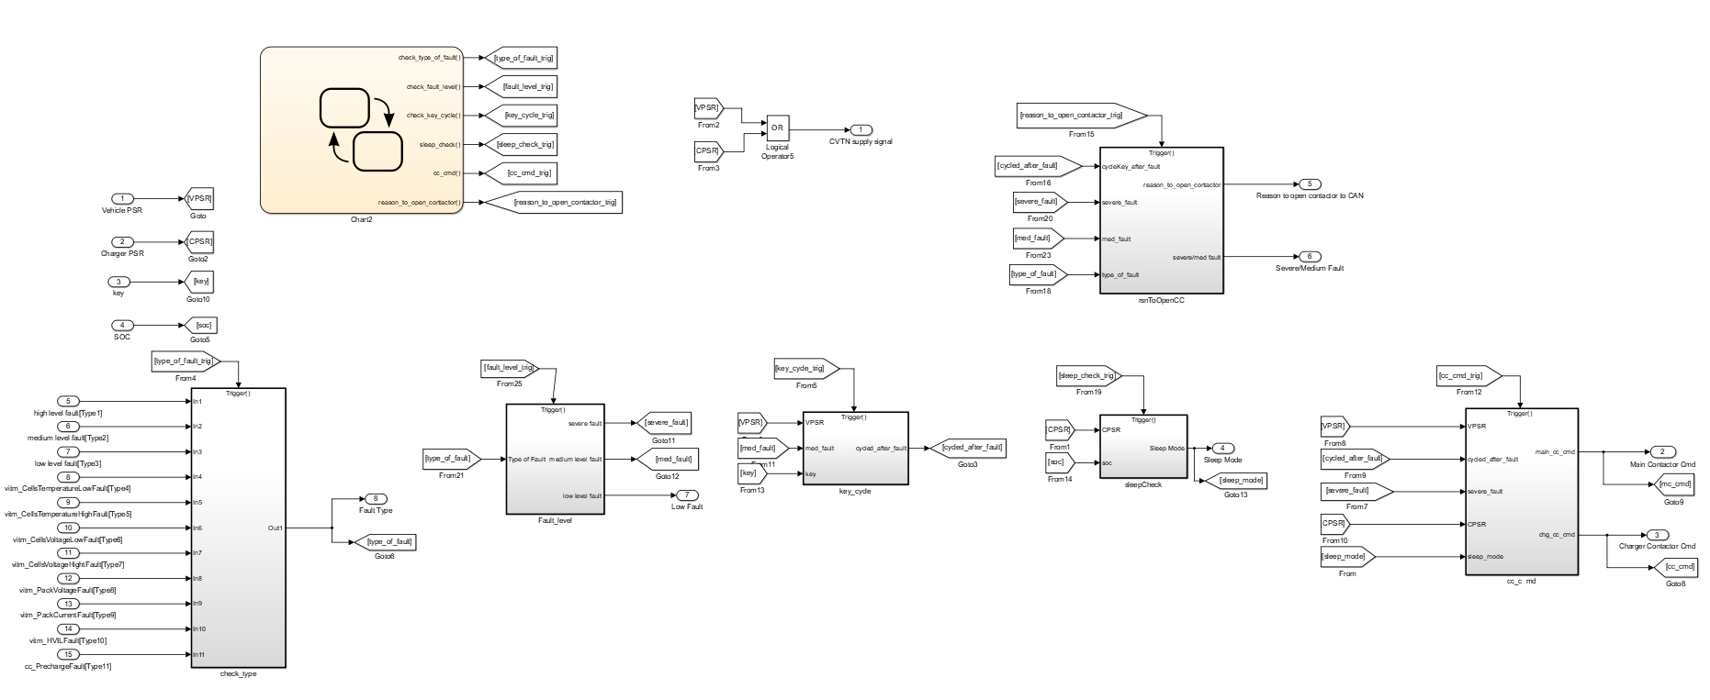
3.2.1 Battery State Control (BSC): Simulink Model
Monitors Key and Charger signal to give appropriate commands to the contactor control module.
Monitors if any features raises a fault, classifies the fault as low, medium or high level and takes appropriate action.
Makes sure contactors are engaged only when there is no fault also check if the key is cycled once a fault is cleared.
BSC also checks the sleep status of battery during charging and is responsible to provide supply signal to slave module.

Slide 27
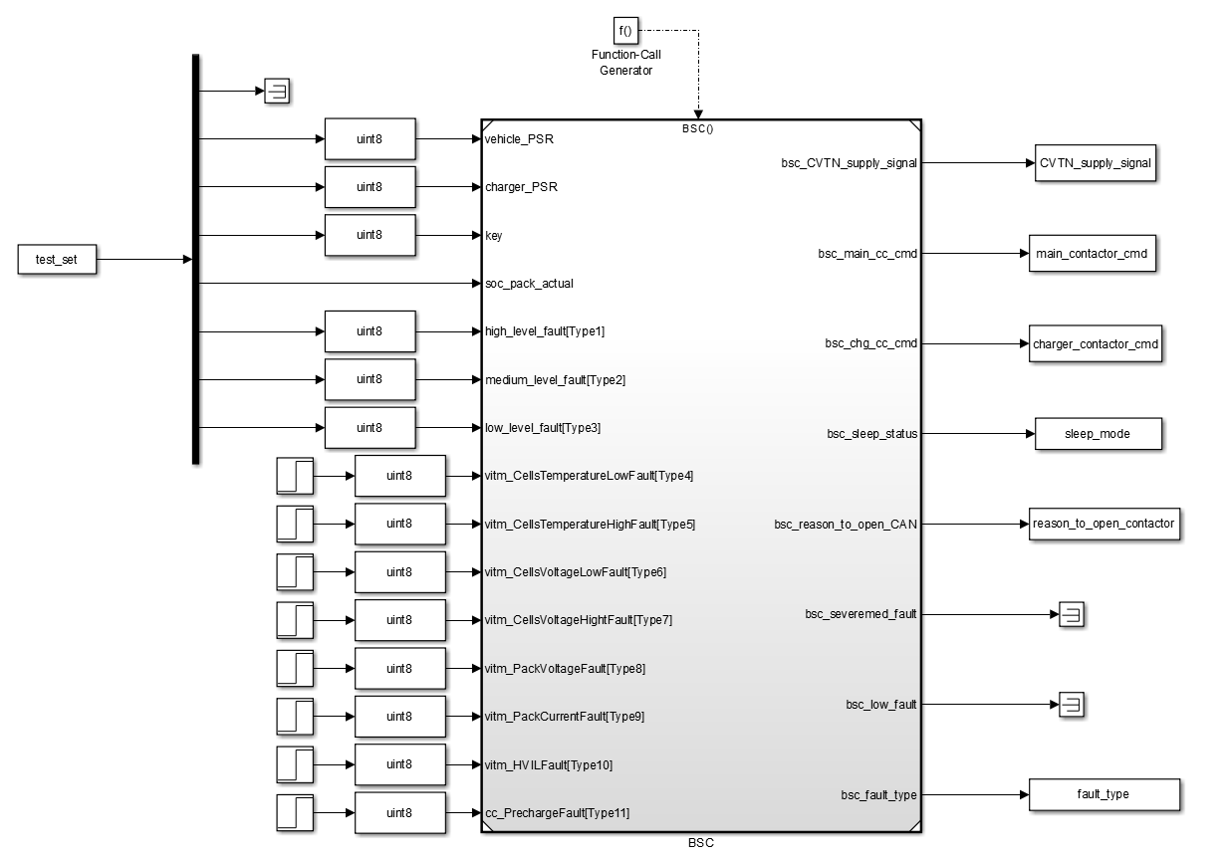
3.2.1 Battery State Control (BSC): Open Loop Testing Harness
The total of 9 requirements associated with BSC have been established
The total of 15 test cases are developed to validate the BSC requirements
Open loop harness is developed to specifically conduct open loop testing
The open loop harness is using model reference block to call the BSC Simulink model

Slide 28
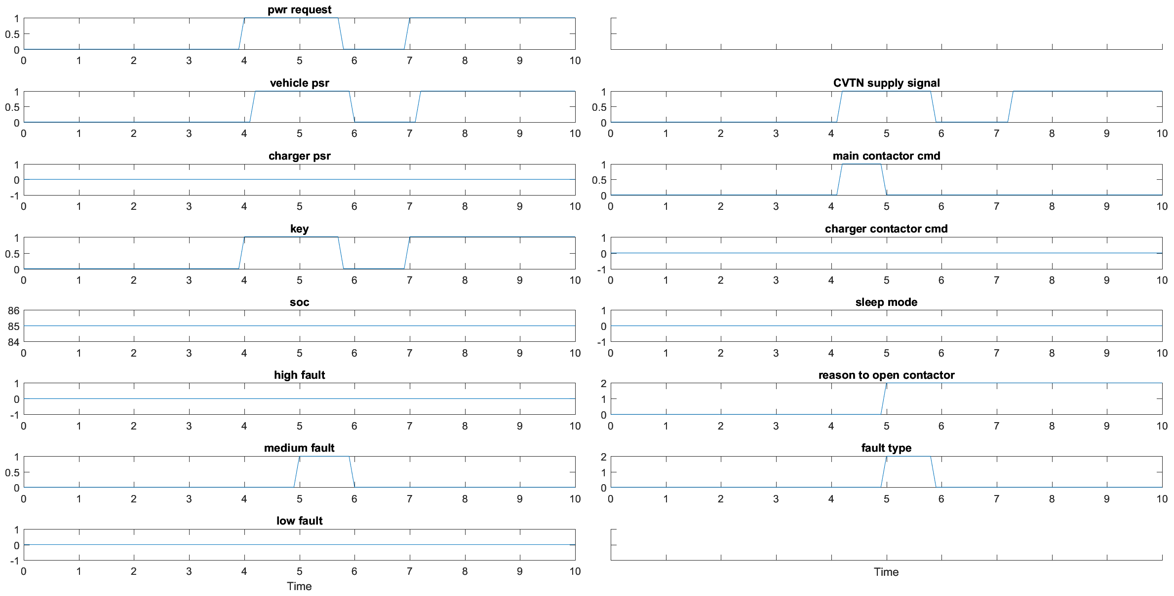
3.2.1 Battery State Control (BSC): Open Loop Test Case 12
Test Case 12: Type-2 Medium Fault and no key-cycle
Description: Induce a Medium Fault when the Key is ON & switch Off and On Key after some time
Expected Result: Initially when the key is connected the main contactor should engage. When a Medium fault occurs the contactors should open and fault number 2 should be broadcasted. The key is turned off before the fault is cleared and is switched on after that. A complete key cycle is not completed since the fault was cleared, and hence the contactors should not engage.

Slide 29
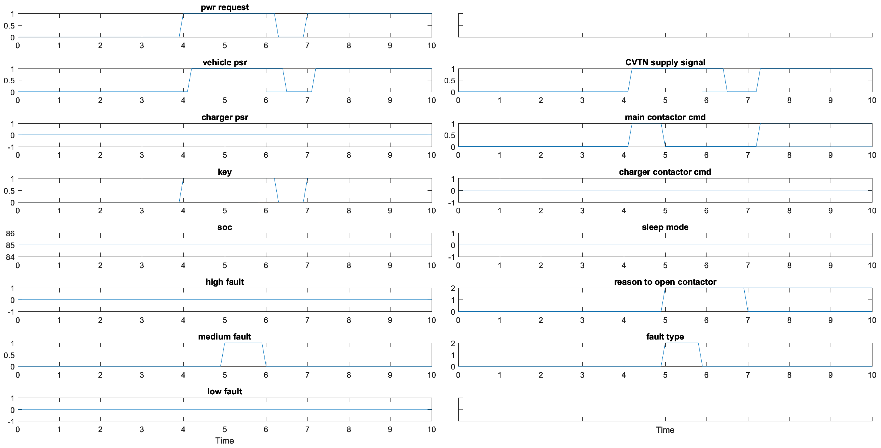
3.2.1 Battery State Control (BSC): Open Loop Test Case 13
Test Case 13: Type-2 Medium Fault and a key-cycle after fault is cleared
Description: Induce a Medium Fault when the Key is ON & switch Off and On Key after some time
Expected Result: Initially when the key is connected the main contactor should engage. When a Medium fault occurs the contactors should open and fault number 2 should be broadcasted. The key is turned off after the fault is cleared and is switched on after that. A complete key cycle is completed since the fault was cleared, and hence the contactors should engage.

Slide 30
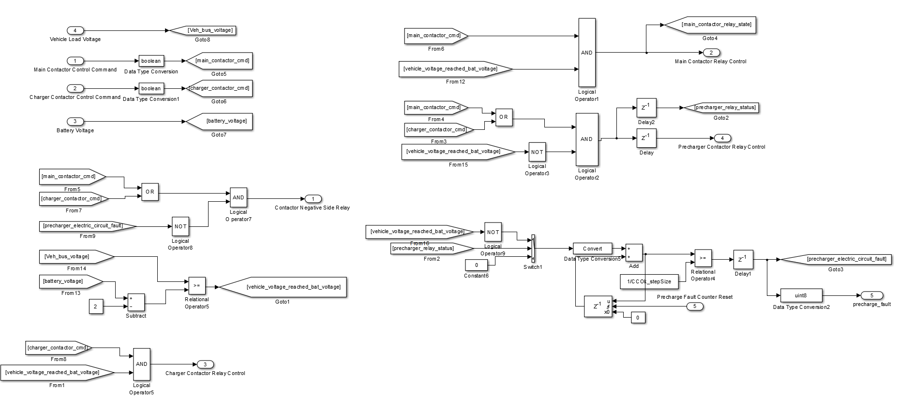
3.2.2 Contactor Control (CC): Simulink Model
Contactor Control directly controls the signals which go-to Main Contactor, Charger Contactor and Negative Contactor.
It also controls the Pre-charger Contactor to prevent any current surge situations.
It checks the vehicle side voltage before closing main contactor and raises a fault signal if any circuit fault is detected.

Slide 31
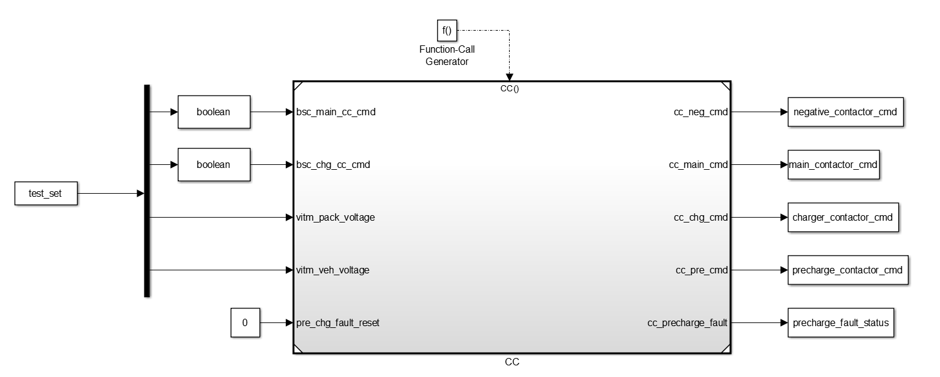
3.2.2 Contactor Control (CC): Open Loop Testing Harness
The total of 7 requirements associated with CC have been established
The total of 5 test cases are developed to validate the CC requirements
Open loop harness is developed to specifically conduct open loop testing
The open loop harness is using model reference block to call the CC Simulink model

Slide 32
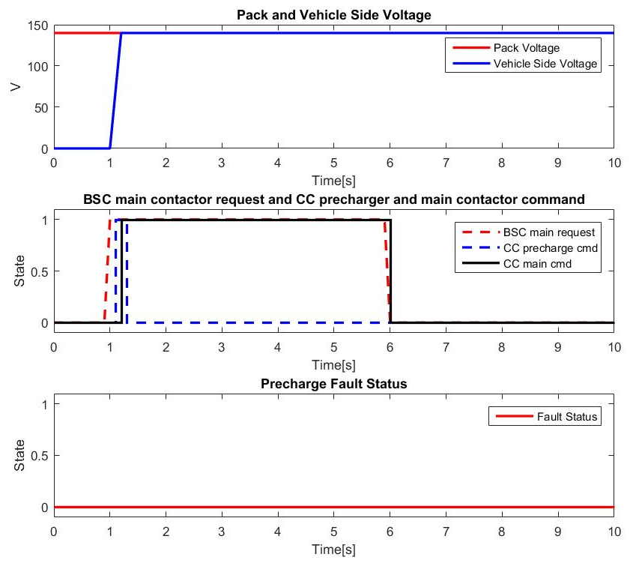
3.2.2 Contactor Control (CC): Open Loop Test Case 3
Test Case 3: Opening Main Contactor
Description: Main Contactor Request from BSC is high and then low after some time
Expected Result: When main contactor engage request is received from BSC, the precharge contactor command should be sent first. Once the vehicle side voltage is within a threshold of the battery voltage the main contactor should be engaged. Once the main contactor is connected, the precharge contactor should be disconnected. When main contactor engage request goes low from BSC, the main contactor should be disengaged.

Slide 33
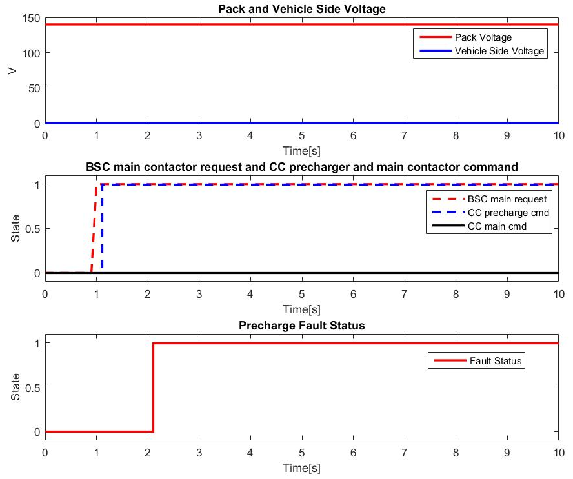
3.2.2 Contactor Control (CC): Open Loop Test Case 5
Test Case 5: Pre-charger Fault Detection
Description: Main Contactor Request from BSC is high and the Vehicle Side Voltage never rises
Expected Result: When main contactor engage request is received from BSC, the precharge contactor command should be sent first. The vehicle side voltage never reaches within the threshold of the battery voltage. When vehicle side voltage fails to reach within the threshold of battery voltage under some set time a precharge fault flag should be raised. When the flag is raised, BSC commands CC to open contactors. Opening of contactor is not observed in this test since it is Open Loop. This test is seen in closed loop tests.

Slide 34
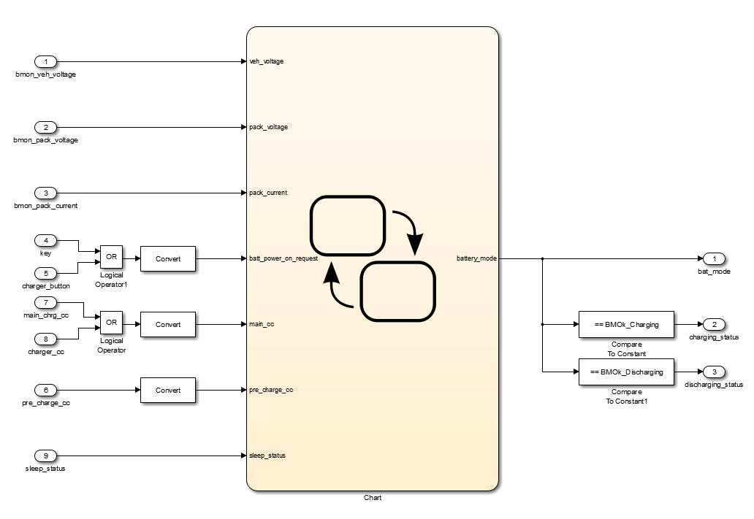
3.2.3 Battery Mode (BMO): Simulink Model
BMO monitors the output of Battery State Control (BSC) and Contactor Control (CC) and decides which mode the battery is in.
BMO detects 8 different mode the Battery can be at any instant of time. These modes are BMS Power Off, BMS Power On, Contactor Closing, Power Closed, Contactor Opening, Charging, Discharging, Charging&Sleep.
BMO helps other features to carry out their functionality depending on what state the battery is in.

Slide 35
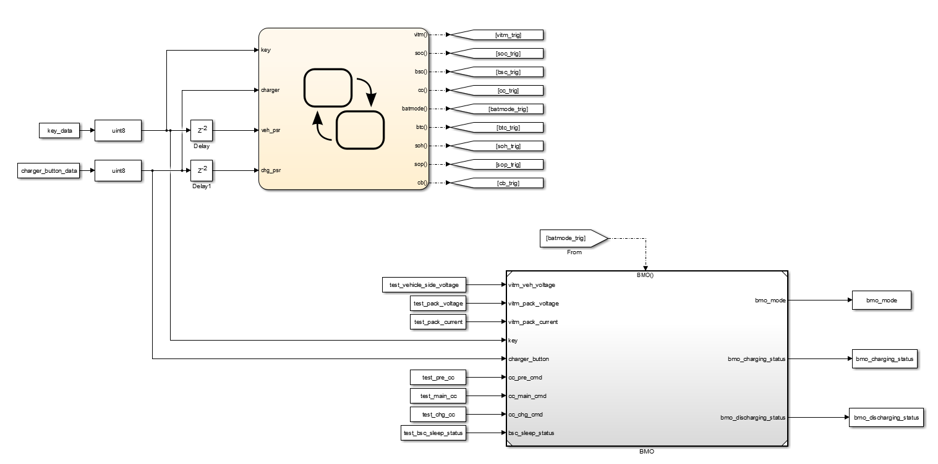
3.2.3 Battery Mode (BMO): Open Loop Testing Harness
The total of 4 requirements associated with BMO have been established
The total of 2 test cases are developed to validate the BMO requirements
Open loop harness is developed to specifically conduct open loop testing
The open loop harness is using model reference block to call the BMO Simulink model

Slide 36
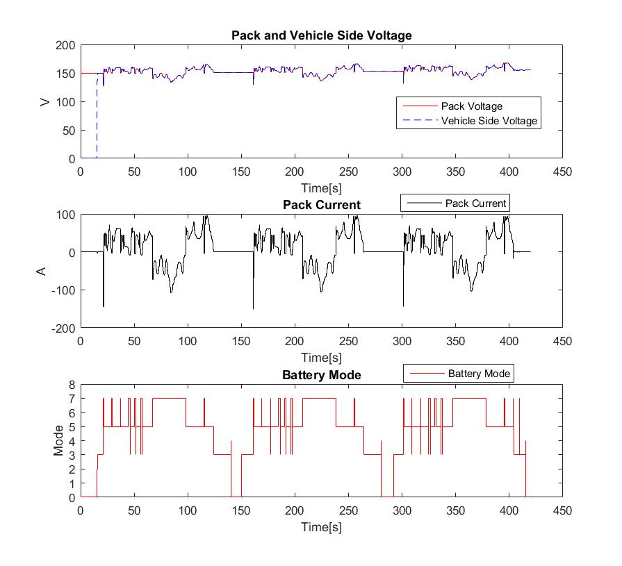
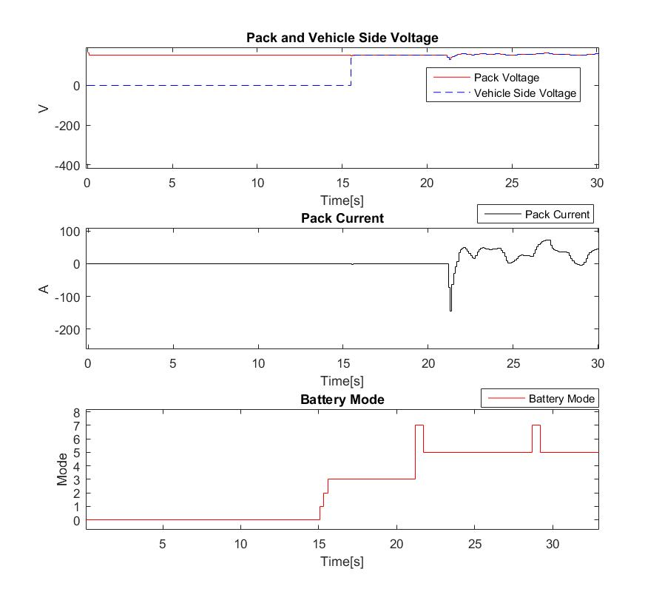
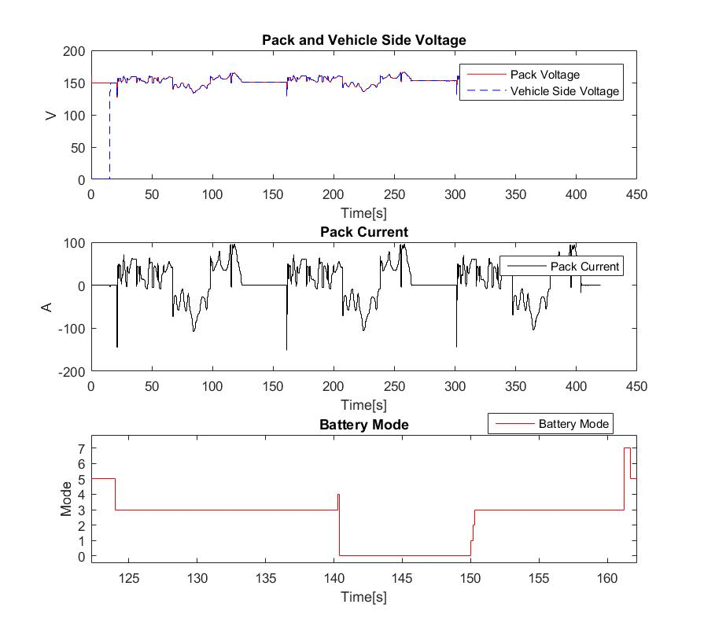
3.2.3 Battery Mode (BMO): Open Loop Test Case 1
Test Case 1: Key On and Off Modes check
Description: Multiple switch On and Off of key following a Drive cycle
Expected Result: When the key is first connected the battery mode should cycle through, Power ON, Contactor closing, Power Closed. The modes then should be either in Charging, Discharging or Power Closed. When the key is turned off, the mode should go-to Contactor Opening and then Power Off
During Key On
During Key Off and then On

Slide 37
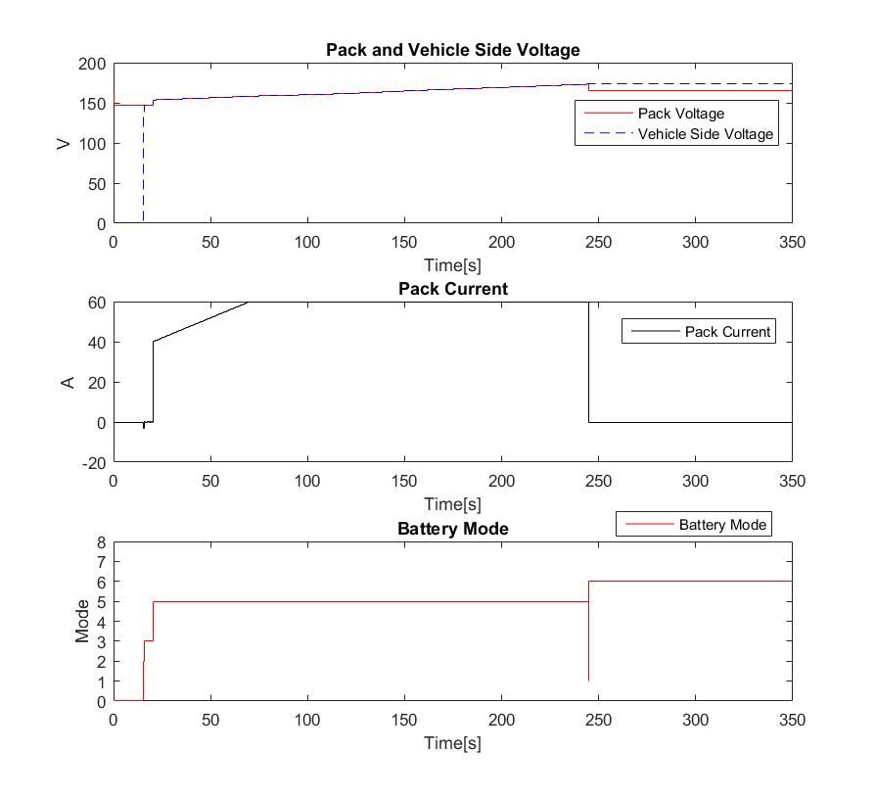

3.2.3 Battery Mode (BMO): Open Loop Test Case 2
Test Case 2: Charger with Sleep Modes check
Description: Switch on Charger, followed by a charging cycle such that SOC crosses max SOC
Expected Result: When the charger is first connected the battery mode should cycle through, Power ON, Contactor closing, Power Closed. When SOC crosses max SOC, the mode should go-to opening contactor and then sleep mode.

Slide 38

3.2.4 State of Charge (SOC): Simulink Model
SOC calculates the amount of charge remaining in the battery. It gives a value from 0% to 100%. It is important to let the user know the amount of charge left in the battery. It is like the indication from a fuel gauge in a gasoline powered car. This allows the user to make the maximum use of the battery.
Also, over-charging or dis-charging a battery can result in reduced lifetime and hence estimation of SOC is necessary.
It is used in other features to calculate state of power, cell balancing commands.
Along with SOC, it also estimates the Capacity degradation of the battery.

Slide 39

3.2.4 State of Charge (SOC): Open Loop Testing Harness
The total of 6 requirements associated with SOC have been established
The total of 4 test cases are developed to validate the SOC requirements
Open loop harness is developed to specifically conduct open loop testing
The open loop harness is using model reference block to call the SOC Simulink model

Slide 40

3.2.4 State of Charge (SOC): Open Loop Test Case 1
Test Case 1: SOC and min/max broadcast
Description: Run Test Drive Cycle with unbalanced cells
Expected Result: Calculated SOC should match with the ground truth SOC. Min and Max SOC across cells should be broadcasted. Since all the cells are not at the same SOC, the min and max SOC can be seen. SOC shown to customer should follow the rule : 1. it is 0 if soc <= SOCLowLimit, 2. it is 100% if soc >= SOCHighLimit 3. Interpolated between 0% and 100%. SOCLowLimit and SOCHighLimit are set to 20% and 80% respectively.
In first figure : solid red line is groundtruth SOC of 40 cells and dashed blue line is calculated SOC

Slide 41

3.2.4 State of Charge (SOC): Open Loop Test Case 2
Test Case 2: SOC Slew Rate Indication
Description: Run a Test Drive Cycle with steep Discharge
Expected Result: When SOC drops at a rate higher than 1% per second a flag should be broadcasted.
In first figure : solid red line is groundtruth SOC of 40 cells and dashed blue line is calculated SOC

Slide 42

3.2.4 State of Charge (SOC): Open Loop Test Case 3
Test Case 3: SOC Accuracy
Description: Run Test Drive Cycle with multiple key-On and induced noise in current sensor.
Expected Result: Multiple Key Off and On should not affect the accuracy of SOC as well as the induced noise. The noise added to pack current sensor is white gaussian noise with 3A standard deviation.
In second figure : solid red line is groundtruth SOC of 40 cells and dashed blue line is calculated SOC

Slide 43
Work Package 3.3: BMS Development Stage 2– V-I-T Monitoring, Battery Thermal Control, SOP and SOH

Slide 44
WP3.3 Recap: BMS Development Stage 2
Target: Develop key features of BMS system (V-I-T monitoring, thermal control, SOP and SOH) and setup RPC for code testing
Task Description
Develop proper architectures for the BMS subsystems: V-I-T monitoring, thermal control, SOP and SOH
Build Simulink blocks for each BMS subsystem
Open loop testing to validate the functionality of each subsystem
RPC setup and initial testing finished
Outputs:
Simulink dummy models with properly defined subsystems and their inputs/outputs
Simulink model established for each BMS subsystem
Integration between Amesim model and BMS subsystems completed in Simulink environment
Open loop test cases results generated and linked to Polarion requirements
RPC properly setup and initial testing of code completed

Slide 45

3.3.1 State of Power (SOP): Simulink Model
Cell SOC and Cell Temperatures are used to determine battery internal resistance
Cell SOC value is used to generate OCV value that is used to compute power limit
Cap cell voltage to min cell voltage during discharging and cap cell voltage to max cell voltage during charging
Power limit is further used to compute the current limit by divide min or max cell voltage

Slide 46

3.3.1 State of Power (SOP): Open Loop Testing Harness
The total of 7 requirements associated with SOP have been established
The total of 8 test cases are developed to validate the SOP requirements
Open loop harness is developed to specifically conduct open loop testing
The open loop harness is using model reference block to call the SOP Simulink model

Slide 47

3.3.1 State of Power (SOP): Open Loop Test Case 1
Test Case 1: Charing Power Limit Calculation
Description: Run 30 seconds cycle: set charging status to be 1 and set cell SOC and cell temperatures randomly at different values in the operation range
Expected Result: SOP feature should provide all correct charge power limit through the drive cycle and the power limit should not exceed maximum power operating range
Cell SOCs
Random Cell Temperatures

Slide 48

3.3.1 State of Power (SOP): Open Loop Test Case 1
Random cell Temperatures
Battery charging power limit
Battery charging current limit
Battery charging power limit is around 12550W and charging current limit is around 74.8A
If power limit is divided by current limit and then divided by 40, the result is approximated to 4.1V
Cell maximum voltage is 4.2 volts, which is similar to the approximated cell voltage, validated computation

Slide 49

3.3.1 State of Power (SOP): Open Loop Test Case 2
Test Case 2: Discharging Power Limit Calculation
Description: Run 30 seconds cycle: set discharging status to be 1 and set cell SOC and cell temperatures randomly at different values in the operation range
Expected Result: SOP feature should provide all correct discharge power limit through the drive cycle and the power limit should not exceed maximum power operating range
Cell SOCs
Random Cell Temperatures

Slide 50

3.3.1 State of Power (SOP): Open Loop Test Case 2
Battery discharging power limit
Battery discharging current limit
Battery discharging power limit is around 12200W and discharging current limit is around 113.5A
If power limit is divided by current limit and then divided by 40, the result is approximated to 2.7V
Cell minimum voltage is 2.7 volts, which is similar to the approximated cell voltage, validated computation

Slide 51

3.3.1 State of Power (SOP): Open Loop Test Case 3
Test Case 3: Discharging Power Limit Calculation under Internal Resistance Variation
Description: Run 30 seconds cycle: set discharging status to be 1 and set cell SOC and cell temperatures randomly at different values in the operation range, set internal resistance scaling factor to be a vector whose elements are between 0.98 to 0.95
Expected Result: SOP feature should provide all correct discharge power limit through the drive cyclethe and be proportionally reduced by the resistance scaling factor
Cell SOCs
Internal resistance scaling factor

Slide 52

3.3.1 State of Power (SOP): Open Loop Test Case 3
Battery discharging power limit:
no internal resistance change
Battery discharging current limit:
no internal resistance change
Battery discharging power and limit discharging current limit are both reduced after internal resistance is increased due to aging effect
The ratio is approximately 96%, around the same value of ratio between original and current internal resistance
Battery discharging power limit:
with internal resistance change
Battery discharging current limit:
with internal resistance change

Slide 53

3.3.2 Battery Thermal Control (BTC): Simulink Model
Target battery temperature is determined based on battery cell temperatures, SOC and charging state
Target battery temperature will set to be within a pre-determined temperature band
Actual battery temperature is set to capture the worst cell temperature case
Error between target and actual temperature is an input to a PID controller to control cooling air flow rate
Cell temperature faults or cooling temperature faults can trigger a pre-determined cooling air flow rate

Slide 54

3.3.2 Battery Thermal Control: Open Loop Testing Harness
The total of 8 requirements associated with BTC have been established
The total of 8 test cases are developed to validate the BTC requirements
Open loop harness is developed to specifically conduct open loop testing
The open loop harness is using model reference block to call the BTC Simulink model

Slide 55

3.3.2 Battery Thermal Control: Open Loop Test Case 1
Test Case 1: Thermal Control High Level Control
Description: Run 10 seconds cycle: during the cycle, set 1) Randomly set maximum cell temperature to be greater than maximum operation high threshold(2s-3s); 2) randomly set minimum cell temperature to be less than minimum operation low threshold (4s-5s); 3) set two cell temperature such that their difference is higher than the given threshold(6s-7s); 4) set all cell temperatures to be within operation range (all other time)
Expected Result: Coolant flow rate should be nonzero for case 1), 2) and 3), but will zero for case 4)
cell SOCs
cell Temperatures

Slide 56

3.3.2 Battery Thermal Control: Open Loop Test Case 1
Battery actual temperature
Battery coolant flow request command
Battery coolant request is 1 during 2s-3s, 4s-5s and 6s-7s when we set the cell temperature abnormal
Actual battery temperature is 43 during 2s-3s and 16 during 4s-5s to capture worst cell temperature
When cell temperatures are not too high or too low, maximum cell temperature will be battery temperature

Slide 57

3.3.2 Battery Thermal Control: Open Loop Test Case 2
Test Case 2: Full Charging Temperature Control
Description: Run 10 seconds cycle: set SOC to be above 95 percent, 1) Set the ambient temperature to be below ambient temperature lower threshold (0s-1s); 2) set the ambient temperature to be above ambient temperature upper threshold (1s-3s); 3) set ambient temperature back to 27 deg C
Expected Result: Target battery temperature should be 1) the maximum temperature lower threshold; 2) the maximum temperature upper threshold; 3) continue to stay
cell SOCs
Ambient Temperatures

Slide 58

3.3.2 Battery Thermal Control: Open Loop Test Case 2
Target battery temperature
Battery coolant flow request command
Battery target temperature is maximum battery temperature lower threshold when ambient temperature is below operating range and is minimum battery temperature upper threshold when ambient temperature above operation range
Coolant flow is required when ambient temperature is too cold or too hot since cell temperature is set to between 30 to 35 degC

Slide 59


3.3.3 VIT Monitoring (VITM): Simulink Model
cell voltage diagnostics and statistical calculation
Cell temperatures, cell voltages, pack voltages, vehicle side voltages, pack current, coolant inlet/outlet temperatures are filtered in the logic
Filtered signal values are used to compute statistical signals of cell temperatures and cell voltages
Filtered signals are also used by diagnostic logic to check if any sensor reading is abnormal and the flag will be raised if sensor reading is out of operating range

Slide 60

3.3.3 VIT Monitoring: Open Loop Testing Harness
The total of 7 requirements associated with BTC have been established
The total of 7 test cases are developed to validate the BTC requirements
Open loop harness is developed to specifically conduct open loop testing
The open loop harness is using model reference block to call the VIT Monitor Simulink model

Slide 61

3.3.3 VIT Monitoring: Open Loop Test Case 1
Test Case 1: cell voltage monitoring and statistical calculation
Description: run 30s cycle, make the maximum cell voltage between 3.3V to 3.7V
Expected Result: Cell voltage should be filtered properly and the min, max and average cell voltage should be calculated and broadcasted by CAN properly
Cell Voltage
Minimum Cell Voltage

Slide 62

3.3.3 VIT Monitoring: Open Loop Test Case 1
Maximum Cell Voltage
Average Cell Voltage
Maximum cell voltage is around 3.7V, upper level between 3.3V and 3.7V
Minimum cell voltage is around 3.3V, lower level between 3.3V and 3.7V
Average cell voltage is around 3.7V, middle level between 3.3V and 3.7V

Slide 63

3.3.3 VIT Monitoring: Open Loop Test Case 2
Test Case 2: cell voltage diagnostic (cell voltage allowable range between 2.7V to 4.2V)
Description: run 30s cycle, make the maximum cell voltage above the given threshold between 3 to 6 seconds and then make the minimum cell temperature below the given threshold for between 9 to 12 seconds
Expected Result: The cell voltage high fault should be 1 after one cell voltage is above the cell voltage high threshold; the cell voltage low fault should be 1 after one cell voltage is below the cell low voltage threshold;
Cell Voltage
Minimum Cell Voltage

Slide 64

3.3.3 VIT Monitoring: Open Loop Test Case 2
Cell Voltage Low Fault
Cell Voltage High Fault
Cell voltage faults are raised after 2 consecutive seconds out of range voltage signals are detected
Cell voltage low fault raised 2 seconds after low cell voltage is detected (initiated at 9s)
Cell voltage high fault raised 2 seconds after high cell voltage is detected (initiated at 3s)

Slide 65



3.3.4 State of Health (SOH): Simulink Model
Nominal internal resistance from lookup table
SOH calculation: estimated internal resistance/nominal resistance
We use delta cell voltage divided by the delta cell current to estimate the internal resistance of each cell
The estimation is only activated when cell temperature and delta cell voltage and current satisfy certain conditions
The ratio between estimated resistance and lookup table based resistance will be used by SOP to calculate power limit
The minimum of all cell ratios between estimated resistance and lookup table based resistance will be the indicator of cell SOH, this value is combined with capacity degradation percentage to arrive at the single SOH index value from 0 to 100

Slide 66

3.3.4 State of Health (SOH): Open Loop Test Case 1
Test Case 1: Charging SOH Calculation and Broadcasting
Description: Set battery state to charging and set voltage difference equal to 1.01 times product between the current difference and battery internal resistance during charging. Set SOH capacity degreation index randomly between 0.97 to 0.98, run cycle for 200 seconds
Expected Result: The battery SOH R index should be 99 and combined SOH index should be between 97 and 98 and broadcasted through CAN bus successfully
Battery capacity degradation factor
Charging contactor status

Slide 67

3.3.4 State of Health (SOH): Open Loop Test Case 1
SOH R index
Final SOH index
SOH R index is gradually converges to 99 as expected since we increased internal resistance by 1 percent
Cell capacity degradation factor is set to between 97 and 98
The Minimum of SOH R index and Cell capacity degradation factor will be used as a single SOH index

Slide 68

3.3.4 State of Health (SOH): Open Loop Test Case 2
Test Case 2: Dis-Charging SOH Calculation and Broadcasting
Description: Set battery state to discharging and set voltage difference equal to 1.02 times production between the current difference and battery internal resistance during discharging. Set SOH capacity degradation index randomly between 0.99 to 1 run cycle for 200 seconds
Expected Result: The battery SOH index should converge to 98 and broadcasted through CAN bus successfully
Battery capacity degradation factor
Main contactor status

Slide 69

3.3.4 State of Health (SOH): Open Loop Test Case 2
SOH R index
Final SOH index
SOH R index is gradually converges to 98 as expected since we increased internal resistance by 2 percent
Cell capacity degradation factor is set to between 99 and 100
The Minimum of SOH R index and Cell capacity degradation factor will be used as a single SOH index
In our test case, final SOH is the SOH R index value shown in the right hand side picture

Slide 70
Work Package 3.4: Cell Balancing, Desktop Closed Loop Testing, RPC Open Loop Testing

Slide 71

3.4.1 Cell Balancing (CB): Simulink Model
Cell balancing for one particular cell will be activated if either one of the following situation occurs
If the difference between that cell SOC and the minimum cell SOC is greater than a threshold
If the difference between that cell voltage and the minimum cell voltage is greater than a threshold
Cell balancing status will be set to 1 if at least one cell is in the balancing process

Slide 72

3.4.1 Cell Balancing: Open Loop Testing Harness
Cell voltage and cell SOC will be used as inputs to determine which cell needs to enter into balancing status
Battery mode input is used to make sure cell balancing is only activated during charging status
Cell balancing command is used to control which cell to balance
Cell balancing status is broadcasted to indicate if there is any cell in balancing process
Three requirements and three test cases are generated for cell balancing feature

Slide 73

3.4.1 Cell Balancing: Open Loop Test Case 1
Test Case 1: cell balancing conditions
Description: Run 30 seconds cycle; set battery mode to discharging for first 5 seconds , and then set battery mode to charging state for the rest of 25 seconds. Set cell SOC to be between 60 to 63 for 15 seconds, all equal to 60 for 10 seconds, and then 40 to 43 for another 5 seconds. Set Cell voltage all equal to 3.4V for 15 seconds and then as between 3.4V and 3.42V for 15 seconds
Expected Result: If we set delta voltage threshold to be 0.015V and delta SOC threshold to be 2, SOC activation threshold to be 60; then we expect that the cell balancing should be disabled for the first 5 seconds and last 5 seconds, and then enabled only during middle 20 seconds. Moreover, cell balancing status should be activated with delta SOC between 5 to 15 seconds and activated with delta voltage between 15 to 25 seconds
Cell Voltage
Cell SOC
Charging Status

Slide 74

3.4.1 Cell Balancing: Open Loop Test Case 1
Cell Balancing Command
Cell Balancing Status
Cell balancing is disabled for the first 5 seconds because battery is not in charging mode
Cell balancing is not activated for the first 5 seconds because SOC is not reach 60
Cell balancing is activated between 5 to 15 seconds since difference between min and max SOC is greater than 2 and is activated between 15 to 25 seconds because difference between min and max cell voltage is greater than 0.015V

Slide 75
3.4.2 Simulink Models Overview
Each feature is developed in a separate Simulink subsystem.
Closed Loop Harness :
Has the Battery Management System controller along with Amesim Battery Pack.
Battery Pack Data is passed from Amesim.
Each feature in the controller is used as model reference.
Each feature can be used with the Simulink blockset subsystem or C code generated s-function subsystem.
Open Loop Harness :
Has the Battery Management System controller.
Stored data can be fed into the controller.
Each feature in the controller is used as model reference.
Each feature can be used with the Simulink blockset subsystem or C code generated s-function subsystem.
Hardware in Loop Harness :
Has the Battery Management System controller along with blocks Analog/Digital/CAN read and write.
Data is fed and results are received by a PC.
Each feature in the controller is used as model reference.
Open Loop Data Transfer Model :
Model has blocks to interface with communication devices and CAN bus.
Feeds data to RPC ECU and stores data received from it.

Slide 76
3.4.3 Closed Loop Simulation Subsections
Simulink Closed Loop Model
FTP72 drive cycle
Test Cases Overview
Test Cases results

Slide 77

3.4.3.1 Simulink Closed Loop Model : Top Level
BMS
Key and Charger Signals
Feedback Displays
Amesim Battery Pack Model
Manual Fault Induction
Data Logger

Slide 78

3.4.3.1 Simulink Closed Loop Model : BMS Subsystem overview
CC
SOC
BMO
BSC
VITM
BTC
CB
SOH
SOP
BMS controller with various features as model reference

Slide 79

3.4.3.2 FTP72 drive cycle Overview
FTP72 drive cycle is used in various test cases in the coming test cases. In some cases a part of cycle is used or a delayed cycle is used.
The U.S. FTP-72 (Federal Test Procedure) cycle is also called Urban Dynamometer Driving Schedule (UDDS) or LA-4 cycle. It concerns light-duty vehicles. The cycle simulates a urban route with frequent stops.
Parallel Hybrid Vehicle model from Amesim is used with the battery specifications mentioned in Amesim Battery Model to capture the power signal. The driver is required to follow the FTP72 cycle.
The data is captured for the first 660seconds.
Amesim Parallel Hybrid Vehicle Model

Slide 80


3.4.3.2 FTP72 drive cycle Speed and Power Data
Figure 1 : Shows the Speed profile of the FTP72 drive cycle.
Figure 2 : Shows the Power Consumption during the drive cycle.

Slide 81
3.4.3.3 Overview of Test Cases
Test Case Number | Test Case Information
1 | FTP72 Cycle with a single Key On.
2 | FTP72 Cycle with multiple Key On and Off sequences. SOC is initialized correctly at every Key On.
3 | FTP72 Cycle with an initial imbalance of SOCs. Cell Balancing control balances the soc throughout the battery.
4 | FTP72 Cycle with an instance of Medium Fault. Battery State Control does not switch On the car until a key cycle is performed
5 | Charging Cycle which is turned off by Battery State Control when max SOC is attained and goes into sleep mode. State of Power controls charging current.
6 | Discharge and Charge Cycle with higher temperature to see Battery Thermal Control in action.
7 | Charging Cycle with an initial degradation in cell capacity. State of Health estimates the capacity degradation.
8 | FTP72 Cycle with an initial degradation in cell resistance. State of Health estimates the resistance degradation.
9 | FTP72 Cycle with an initial degradation in cell resistance, initial imbalance of SOCs along with higher temperature. A medium and low level fault is introduced during the run.
10 | Charging Cycle followed by a FTP72 cycle with an initial degradation in cell capacity, cell resistance, initial imbalance of SOCs along with higher temperature

Slide 82
3.4.3.4 CL Test 1 : Description and Objective
Test Case Description
FTP 72 load cycle is given as input
Key is switched ON at 15seconds
Initial SOC of cells is set to 60%
Air, Cell Temperatures are initialized at 35 degree Celsius
Observations and Results are shown in coming slides
Test Case Objective
Validate BSC, CC, SOC, SOH internal resistance calculation and thermal mechanics of Amesim model.
Unrestricted

Slide 83

3.4.3.4 CL Test 1 : Observations Contactor Switching on Key On
Figure : Key Signal and Contactors
Once the key is turned On the BMS wakes up.
BSC commands CC to close the contactors.
Figure on the right shows Key signal go high at 15s
Following that the Pre-charge Contactors goes high
Once the vehicle side voltage is equal to battery voltage, the Main Contactor is closed and after that, the Pre-charge Contactor is opened.

Slide 84

3.4.3.4 CL Test 1 : Observations Voltages during Key On
Figure : Switching ON of Contactors
Figure on the right shows, Vehicle Side Voltage and Battery Voltage on the left y-axis. Pre-charge and Main Contactor status are shown on the right y-axis.
In this case, the Vehicle side capacitor is discharged and hence Pre-charge contactor is connected first.
Once the Vehicle side voltage is within 2Volts of battery voltage, the main contactor is closed and the pre-charge contactor is opened.
Once the contactor closing process is complete, the vehicle side and battery voltages are same.

Slide 85


3.4.3.4 CL Test 1 : Observations Battery Mode at Key On and during Drive Cycle
Figure : Battery voltage, current and mode
Figure below shows the pack voltage, vehicle side voltage, pack current and the battery mode.
Battery Modes are defined in the BMO feature description.
A zoomed version of Battery mode during key on is shown on the left.
It is seen that the Battery goes through the following modes at the beginning
0 : Battery Power Off
1 : Battery Power On
2 : Battery Contactors Closing
3 : Battery Power Connected
The battery then cycles between
7 : Battery Discharging
5 : Battery Charging
3 : Battery Power Connected

Slide 86

3.4.3.4 CL Test 1 : Observations SOC Calculation
Figure : Ground Truth SOC from Amesim and BMS calculated SOC
Figure on the right shows the ground truth SOC in red and calculated SOC using Coulomb Counting in dashed blue.
Since there are 40 cells, there are 80 signals plotted in the figure.
The calculated SOC is very close to the ground truth SOC. The rmse is 0.2%.

Slide 87

3.4.3.4 CL Test 1 : Observations Internal Resistance Estimation
Figure : Estimated Internal Resistance
There is no resistance degradation in this test case.
The resistance degradation factor is calculated as mentioned in SOH feature description.
The alpha for the low pass filter can be further reduced for a very gradual change in internal resistance measurement.
The plot on right has 40 signals for 40 cells.
Degraded resistance is present in test case 8.
In the figure on right, we see the estimated resistance factors are almost 1 as there is no degradation of cell resistance

Slide 88

3.4.3.4 CL Test 1 : Observations Thermal Mechanics in the battery model
Figure : Cell Temperatures
All the cells begin at 35 degree Celsius.
The temperature rises gradually as shown on the right. The plot has 40 signals for 40 cells.
BTC is activated once any cell temperature crossed 40 degree Celsius. This is observed in test case 6.

Slide 89
3.4.3.4 CL Test 2 : Description and Objective
Test Case Description
FTP 72 load cycle is given as input
The Key signal is switched Off and On a couple of times
Initial SOC of cells is set to 60%
Air, Cell Temperature are initialized at 35 degree Celsius
Observations and Results are shown in coming slides
Test Case Objective
Validate BSC, CC, SOC, SOH internal resistance calculation.
Validate SOC initializes correctly on key on and off operations. SOC from coulomb counting depends on initial value. If initialized incorrectly, it could lead to a significant constant bias in the result.
Validate Battery Mode switches correctly during key on and off operations.

Slide 90

3.4.3.4 CL Test 2 : Observations Key signal input and contactor closing
Figure : Key Signal and Contactors
This has similar closing operations to Test Case 1.
There are multiple key off and on operations.
The Pre-charge contactor is closed at first key on when the vehicle side capacitor is not charged. In later key-on operations the capacitor is already charged and hence it is not closed.

Slide 91


3.4.3.4 CL Test 2 : Observations Battery Mode at Key On Off operations and during Drive Cycle
Figure : Battery Voltage, current and Mode
Figure below shows the pack voltage, vehicle side voltage, pack current and the battery mode.
Battery Modes are defined in the BMO feature description.
The Battery goes through the same modes at the beginning as shown in Test Case 1
A zoomed version of Battery mode is shown on the left when the key is turned off and on.
The battery goes through the following modes during 130s to 155s shown in the bottom left picture:
3 : Battery Power Connected
4 : Battery Contactors Opening
0 : Battery Power Off
1 : Battery Power On
2 : Battery Contactors Closing
3 : Battery Power Connected

Slide 92

3.4.3.4 CL Test 2 : Observations Consistent SOC estimation during key on and off
Figure : GroundTruth SOC from Amesim and BMS calculated SOC
Figure on the right shows the ground truth SOC in red and calculated SOC in dashed blue.
Since there are 40 cells, there are 80 signals plotted in the figure.
The multiple key off and on operations do not affect the SOC estimation and is initialized correctly at every key on as described in SOC feature.

Slide 93

3.4.3.4 CL Test 2 : Observations Consistent Internal Resistance estimation during key on and off
Figure : Estimated Internal Resistance
There is no resistance degradation in this test case.
The resistance degradation factor is calculated as mentioned in SOH feature description.
The alpha for the low pass filter can be further reduced for a very gradual change in internal resistance measurement.
The plot on right has 40 signals for 40 cells.
Degraded resistance is present in test case 8.
We see that multiple key off and on operation has not affected the estimation of internal resistance. The estimated resistance factors are almost 1 as expected.

Slide 94
3.4.3.4 CL Test 3 : Description and Objective
Test Case Description
FTP 72 load cycle is given as input
Cell 10,20,30,40 are initialized with an imbalance SOC of 58%. All other cells are initialized with 60%.
Threshold for SOC deviation to activate cell balancing is set to 0.1%
Air, Cell Temperature are initialized at 35 degree Celsius
Observations and Results are shown in coming slides
Test Case Objective
Validate Cell Balancing balances the SOC of all the cells.
Validate that estimation of SOC takes into account the current variation due to cell balancing in different cells.

Slide 95

3.4.3.4 CL Test 3 : Observations Correct SOC estimation even with uneven current across cells
Figure : GroundTruth SOC from Amesim and BMS calculated SOC
Figure on the right shows the ground truth SOC in red and calculated SOC in dashed blue.
Since there are 40 cells, there are 80 signals plotted in the figure.
SOC of cells are initialized correctly at 58% and 60%.
As time passes the SOC of all the cells is matched by cell balancing.
SOC estimation is consistent with the groundtruth.

Slide 96

3.4.3.4 CL Test 3 : Observations Cell Balancing Commands
Figure : Cell Balancing commands are activated only during regen mode
Figure on the right shows the cell balancing commands.
Since there are 40 cells, there are 40 signals plotted in the figure.
Plots in next slides show the comparison of current and cell balancing commands between a balanced and imbalanced cell.

Slide 97

3.4.3.4 CL Test 3 : Observations Current and Balancing Command between cells
Figure : Current and Cell Balancing Command comparison between cell 1(initialized at 60%) and 10(initialized at 58%)
Figure below shows that the cell balancing command is switched On while charging for cell 1 so that the current passed through cell 1 is lesser compared to cell 10.
Once the cells are balanced around 390s, no more balancing takes place.
A zoomed version of the figure is present on next slide

Slide 98

3.4.3.4 CL Test 3 : Observations Current and Balancing Command between cells
Figure : Current and Cell Balancing Command comparison between cell 1 and 10 [Zoomed]
During 360s and 400s, when the cell balancing command is On, the current in cell 10 is more than the current in cell 1 due to cell balancing effect as cell 10 has lower SOC than cell 1. Once the cells are balanced around 390s, no more balancing takes place.

Slide 99

3.4.3.4 CL Test 3 : Observations Consistent Internal Resistance estimation during imbalance SOC
Figure : Estimated Internal Resistance Factors
There is no resistance degradation in this test case.
The resistance degradation factor is calculated as mentioned in SOH feature description.
The alpha for the low pass filter can be further reduced for a very gradual change in internal resistance measurement.
In the figure on right, we see the estimated resistance factors are almost 1. The plot has 40 signals for 40 cells.
Degraded resistance is present in test case 8.
Even with imbalance of cell SOCs there is no effect on estimation of resistance factors. The estimated resistance factors are almost 1 as expected.

Slide 100
3.4.3.4 CL Test 4 : Description and Objective
Test Case Description
FTP 72 load cycle is given as input.
A medium fault of Type 2 is induced.
Initial SOC of cells is set to 60%.
Air, Cell Temperature are initialized at 35 degree Celsius.
Observations and Results are shown in coming slides.
Test Case Objective
Validate BSC manages fault condition correctly and communicates the reason to open the contactor.
Validate that contactors are engaged only once the key is cycled after the fault is cleared.

Slide 101


3.4.3.4 CL Test 4 : Observations Contactor switching during fault
Figure : Key, Main Contactor and Medium[Type 2] Fault
Figure below shows the Key signal, Fault Status and Main Contactor Status. The figure on right is a zoomed version during fault.
A Medium Fault [Type 2] is induced at 142s and is cleared manually at 145s.
The main contactor opens when the fault occurs. The key is cycled after the fault is cleared. Once the key cycled the main contactor closes again.

Slide 102

3.4.3.4 CL Test 4 : Observations Fault which opened the contactor
Figure : Reason to Open Contactor
When the fault occurs and the main contactor is opened and the fault number which caused the opening of the contactor is broadcasted.
In the figure on the right it is seen the value of signal is 2 during the time when the contactor was opened due to fault.

Slide 103
3.4.3.4 CL Test 5 : Description and Objective
Test Case Description
Charging Signal is given to simulate a socket charging.
Charging current is ramped up from 40A to 60A and is kept constant after that.
Initial SOC is set to 50%.
Max SOC is set to 95%.
Air, Cell Temperature are initialized at 35 degree Celsius.
Observations and Results are shown in coming slides.
Test Case Objective
Validate that the charging current provided is saturated correctly from the data of SOP.
Validate that the cell voltages do not cross the max cell voltage of 4.2V.
Validate that once SOC reaches the max value, charge contactor is opened and the battery mode switches to Sleep mode.

Slide 104

3.4.3.4 CL Test 5 : Observations Consistent SOC estimation
Figure : GroundTruth SOC from Amesime and BMS Calculated SOC
Figure on the right shows the ground truth SOC in red and calculated SOC in dashed blue.
Since there are 40 cells, there are 80 signals plotted in the figure.
Cell SOCs increase gradually till 95% and is then held at that value since charger contactor is disconnected.

Slide 105


3.4.3.4 CL Test 5 : Observations Battery mode and Contactor at max SOC
Figure : Calculated SOC, Charger Signal, Charger Contactor and Battery Mode
In figure below we can see that once SOC reaches 95%, charger contactor is opened though the charger signal is still On.
The beginning sequence of Battery Modes is same as shown in Test Case 1.
A zoomed version of Battery mode is shown on the left when SOC reaches max value.
The battery goes through the following modes when the SOC reaches max value:
5 : Battery Charging
4 : Battery Contactors Opening
1 : Battery Power On
6 : Battery Sleep Mode
Once the SOC reaches max value, the contactors are opened but the charger is still connected. Hence the battery mode is Sleep.

Slide 106


3.4.3.4 CL Test 5 : Observations Correct charging current saturation
Figure 1: Charging Current applied and Current Limit from SOP
A charging ramp current is provided from 40A to 50 A from 20s to 70s.
The current is held at 60A after that.
Once 60A is above the Charging Current Limit, the max charging current calculated by SOP is used. This makes sure we do not cross the max voltage of the cells as shown in the figure below.
Figure 2 : Cell Voltages
SOP calculates the current which can be input to the battery without crossing the voltage limits which damages the battery. In this case SOP avoids cell voltage to cross max voltage of 4.2V.

Slide 107
3.4.3.4 CL Test 6 : Description and Objective
Test Case Description
FTP 72 load cycle is given as input
Initial SOC is set to 60%.
Air, Cell Temperature are initialized at 39 degree Celsius
Cabin Temperature provided for cooling is set to 25 degree Celsius
Observations and Results are shown in coming slides.
Test Case Objective
Validate that once a cell crosses 40 degree Celsius the BTC supplies the air inlet to cool the pack.
Validate that the temperature doesn’t continue to rise above 40 degree Celsius.
Validate that SOC and internal resistance estimation is not affected due to different temperature across cells.

Slide 108

3.4.3.4 CL Test 6 : Observations Coolant Flow command
Figure : Cell Temperatures and Cooling Flow command
Left y-axis shows the temperature and Right y-axis shows the flow command.
BTC maintains the temperature of all cells below 40 degree Celsius as described as expected and described in BTC feature.
Dispersion in temperature is seen because the inlet of air is from one end of the battery. Thus the cells closest to the battery see a drop in temperature faster than the cells away from the inlet.

Slide 109

3.4.3.4 CL Test 6 : Observations Consistent SOC estimation
Figure : GroundTruth SOC from Amesim and BMS calculated SOC
Figure on the right shows the ground truth SOC in red and calculated SOC in dashed blue.
Since there are 40 cells, there are 80 signals plotted in the figure.
The dispersion in the temperature does not affect the SOC estimation

Slide 110

3.4.3.4 CL Test 6 : Observations Internal Resistance Estimation
Figure : Estimated Internal Resistance Factors
There is no resistance degradation in this test case.
The resistance degradation factor is calculated as mentioned in SOH feature description.
The alpha for the low pass filter can be further reduced for a very gradual change in internal resistance measurement.
The plot has 40 signals for 40 cells.
In the figure on right, we see the estimated resistance factors are almost 1 which is the correct value. Dispersion in temperature causes a very little change in the internal resistance estimation and overall the estimation is correct.

Slide 111
3.4.3.4 CL Test 7 : Description and Objective
Test Case Description
Charging Signal is given to simulate a socket charging.
Charging current is ramped up from 40A to 60A.
Once the current reaches 60A, the charging is switched off. And the key signal is given to the car.
Initial Capacity of cells is degraded to 98%.
Initial SOC is set to 60%.
Once the car starts after a charging cycle the SOH estimation for capacity is updated as discussed in SOH feature.
In an actual car a sudden 2% drop in capacity will never happen. It falls very gradually. It is performed here to show that the Capacity estimation feature is working as intended.
Observations and Results are shown in coming slides.
Test Case Objective
Validate that once the key is turned on after the charging cycle, the capacity degradation factors are updated.
Validate that the SOH index shown for customer does not fall sharply when it is updated on key on

Slide 112

3.4.3.4 CL Test 7 : Observations Key and Charger operation during the testcase
Figure : Key, Charger signal and contactors
Charger signal goes high at 15s which connects the Charger contactor.
Charging is switched off at 70s
The key signal goes high then after few seconds, which causes the main contactor to go high.
When the car is started after a charging cycle, the capacity degradation is calculated and updated as explained in SOC and SOH feature.

Slide 113

3.4.3.4 CL Test 7 : Observations Correct capacity degradation estimation
Figure : Capacity Degradation Estimation
In the figure on right it is seen that, as soon as the key is started at 73s after the charging cycle, the capacity degradation factor is calculated.
The plot has 40 signals for 40 cells.
The capacity degradation estimation of 2% as 0.98 is estimated correctly.
The Low Pass filter for Capacity Degradation is switched off in this case to show the 2% drop. The filter can be switched ON in usual scenarios as the capacity doesn’t fall suddenly drop 2%.

Slide 114

3.4.3.4 CL Test 7 : Observations Correct resistance degradation estimation
Figure : Estimated Internal Resistance Factors
There is no resistance degradation in this test case.
The resistance degradation factor is calculated as mentioned in SOH feature description.
The alpha for the low pass filter can be further reduced for a very gradual change in internal resistance measurement.
The plot has 40 signals for 40 cells.
In the figure on right, we see the estimated resistance factors are almost 1 which is the correct value. As there is no degradation in the resistor, the factor remains at 1 as expected.
Degraded resistance is present in test case 8.

Slide 115

3.4.3.4 CL Test 7 : Observations SOH Battery Degradation index for customer
Figure : Battery Degradation Index for customer
The battery degradation index is a single value and is the minimum of capacity degradation factors and resistance degradation factors. The value is passed through a Low Pass filter.
The low pass filter is used to allow gradual change in degradation index.
This value is updated every time a key or a charger is connected.
In the figure on right we see the drop in the index is much smaller that 2% as required.
We want this index to reach the actual degradation percentage slowly, by getting updated every-time the key or charger is connected.

Slide 116
3.4.3.4 CL Test 8 : Description and Objective
Test Case Description
FTP 72 load cycle is given as input.
Initial SOC is set to 60%.
Initial Resistance of cells is degraded to 98%.
Air, Cell Temperature are initialized at 35 degree Celsius.
Observations and Results are shown in coming slides.
In an actual car a sudden 2% drop in resistance quality will never happen. It falls very gradually. It is performed here to show that the Resistance estimation feature is working as intended.
Test Case Objective
Validate that SOH estimates the degraded resistance correctly.
Validate SOC estimation is correct.

Slide 117

3.4.3.4 CL Test 8 : Observations Correct SOC estimation
Figure : GroundTruth SOC from Amesim and BMS Calculated SOC
Figure on the right shows the ground truth SOC in red and calculated SOC in dashed blue.
Since there are 40 cells, there are 80 signals plotted in the figure.
The calculated SOC is very close to the groundtruth SOC. The degradation in the resistances does no affect SOC estimation calculation as expected.

Slide 118

3.4.3.4 CL Test 8 : Observations Correct estimation of internal resistance
Figure : Estimated Internal Resistance Factors
There is a 2% resistance degradation in this test case.
The resistance degradation factor is calculated using change in current and voltage across each cell as mentioned in SOH feature description.
The alpha for the low pass filter can be further reduced for a very gradual change in internal resistance measurement.
The plot has 40 signals for 40 cells.
It is seen all the resistance factors gradually reduce and settle to 98% as expected.

Slide 119
3.4.3.4 CL Test 9 : Description and Objective
Test Case Description
FTP 72 load cycle is given as input. This test is a combination of various test cases.
Initial SOC is set to 60%. There is an imbalance of SOCs in 4 cells (10,20,30,40) and are set to 58%
Initial Resistance of cells is degraded to 98%.
A medium [Type2] and low[Type3] fault is induced during the run.
Air, Cell Temperature are initialized at 39 degree Celsius. BTC comes in action when the temperature crossed 40degree Celsius.
Observations and Results are shown in coming slides.
In an actual car a sudden 2% drop in resistance quality will never happen. It falls very gradually. It is performed here to show that the Resistance estimation feature is working as intended.
Test Case Objective
Validate that BSC operates correctly during faults.
Validate that SOP de-rates during a low fault.
Validate that the cell balancing does not affect SOC estimation.
Validate correct working of SOH, BTC, cell balancing.

Slide 120


3.4.3.4 CL Test 9 : Observations Contactor switching during fault
Figure : Key, Main Contactor, Medium[Type 2] Fault and Low[Type 3] Fault
Figure below shows the Key signal, Fault Statuses and Main Contactor Status. The figure on right is a zoomed version during fault.
A Medium Fault [Type 2] is induced at 142s and is cleared manually at 145s.
The main contactor opens when the fault occurs. The key is cycled after the fault is cleared. Once the key cycled the main contactor closes again.
No action is taken by contactors when the low fault occurs as expected.

Slide 121


3.4.3.4 CL Test 9 : Observations Reason to open contactors and fault type
Figure 1 : Reason to Open Contactor
When the fault occurs and the main contactor is opened and the fault number which caused the opening of the contactor is broadcasted.
In the figure 1 on the right it is seen the value of signal is 2 during the time when the contactor was opened due to medium type 2 fault.
Figure 2 : Fault Type
In faults when the contactors are not opened the fault type can still be accessed from BSC.
In the figure 2 on the right it is seen the value of signal is 2 during the time of medium type 2 fault and is 3 during low type 3 fault.

Slide 122

3.4.3.4 CL Test 9 : Observations SOP derating during Low Fault
Figure : Max Current Limit during Low Fault
When a low fault occurs, SOP reduces the max current limits by half.
The figures below shows when the low fault occurred, the max current limit is reduced as expected. Since the battery is in regenerative mode during the low fault, the charging current limit has reduced to half.

Slide 123

3.4.3.4 CL Test 9 : Observations Consistent SOC estimation
Figure : GroundTruth SOC from Amesim and BMS Calculated SOC
Figure on the right shows the ground truth SOC in red and calculated SOC in dashed blue.
Since there are 40 cells, there are 80 signals plotted in the figure.
The imbalanced cells begin at 58% and other cells begin at 60% as expected.
As time passes the SOC of all the cells is matched by cell balancing.
The occurrence of medium or low fault does not affect SOC calculation as expected.
The degradation in the resistances does no affect SOC estimation as expected.

Slide 124

3.4.3.4 CL Test 9 : Observations Cell Temperatures
Figure : Cell Temperatures and Cooling Flow command
Left y-axis shows the temperature and Right y-axis shows the flow command.
BTC maintains the temperature of all cells below 40 degree Celsius as described as expected and described in BTC feature.
Dispersion in temperature is seen because the inlet of air is from one end of the battery. Thus the cells closest to the battery see a drop in temperature faster than the cells away from the inlet.

Slide 125

3.4.3.4 CL Test 9 : Observations Resistance Degradation Estimation
Figure : Estimated Internal Resistance Factors
There is a 2% resistance degradation in this test case.
The resistance degradation factor is calculated using change in current and voltage across each cell as mentioned in SOH feature description.
The alpha for the low pass filter can be further reduced for a very gradual change in internal resistance measurement.
The plot has 40 signals for 40 cells.
It is seen all the resistance factors gradually reduce and settle to 98% as expected.
The dispersion in temperature causes a very little change in the internal resistance estimation and overall the estimation is correct.

Slide 126
3.4.3.4 CL Test 10 : Description and Objective
Test Case Description
A charging cycle followed by a FTP 72 load cycle is given as input. The charger is connected again at end with zero current though. This test is a combination of various test cases.
Initial SOC is set to 60%. There is an imbalance of SOCs in 4 cells (10,20,30,40) and are set to 58%
Initial Resistance of cells is degraded to 98%.
Initial Capacity of cells is degraded to 98%.
Air, Cell Temperature are initialized at 39 degree Celsius. BTC comes in action when the temperature crossed 40degree Celsius.
Observations and Results are shown in coming slides.
In an actual car a sudden 2% drop in capacity and resistance quality will never happen. It falls very gradually. It is performed here to show that the Resistance and Capacity estimation feature is working as intended.
Test Case Objective
Validate that SOH index for customer is updated correctly when the key or charger is connected.
Validate that the cell balancing does not affect SOC estimation.
Validate SOH calculates the correct degradation in resistance.
Validate the correct working of BTC, cell balancing.

Slide 127



3.4.3.4 CL Test 10 : Observations Key, Charge signal and Contactors during the test
Figure : Key, Charger Signal and Contactors
A charging signal is given at beginning followed by a key signal.
Charge is connected again at the end after the end of the drive cycle.
Corresponding contactors are switched correctly.
A zoomed version of the figure is shown on the right for the beginning(green box) and ending (red box) portions.

Slide 128


3.4.3.4 CL Test 10 : Observations Battery Mode
Figure : Battery Voltage, current and Mode
Figure on the right shows the pack voltage, vehicle side voltage, pack current and the battery mode.
Battery Modes are defined in the BMO feature description.
A zoomed version of Battery mode is shown on the left for the initial period in which the charger is first connected ay 15s and then disconnected at 73s. The key is then connected at 77s.
The Battery mode gives the correct mode throughout the test.

Slide 129

3.4.3.4 CL Test 10 : Observations Consistent SOC estimation
Figure : GroundTruth SOC from Amesim and BMS Calculated SOC
Figure on the right shows the ground truth SOC in red and calculated SOC in dashed blue.
Since there are 40 cells, there are 80 signals plotted in the figure.
The imbalanced cells begin at 58% and other cells begin at 60% as expected.
As time passes the SOC of all the cells is matched by cell balancing.
The capacity degradation is taken into account during SOC computation and estimation is correct.
The degradation in the resistances does no affect SOC estimation as expected.
Even after the charger is disconnected and the key is connected at beginning, SOC is initialized and estimated correctly.

Slide 130

3.4.3.4 CL Test 10 : Observations Cell Temperatures
Figure : Cell Temperatures and Cooling Flow command
Left y-axis shows the temperature and Right y-axis shows the flow command.
BTC maintains the temperature of all cells below 40 degree Celsius as described as expected and described in BTC feature.
Dispersion in temperature is seen because the inlet of air is from one end of the battery. Thus the cells closest to the battery see a drop in temperature faster than the cells away from the inlet.

Slide 131

3.4.3.4 CL Test 10 : Observations Capacity Degradation Estimation
Figure : Capacity Degradation Estimation
In the figure on right it is seen that, as soon as the key is started at 73s after the charging cycle, the capacity degradation factor is calculated.
The plot has 40 signals for 40 cells.
The capacity degradation estimation of 2% as 0.98 is estimated correctly.
The Low Pass filter for Capacity Degradation is switched off in this case to show the 2% drop. The filter can be switched ON in usual scenarios as the capacity doesn’t fall suddenly drop 2%.
Here we see there is a slight difference between some cells, which is due to the fact that there is a small error during SOC initializations. But this error will not affect SOC estimation drastically and will keep the error well within requirements. Every time the key or charger is connected the SOC is reinitialized if it is off by 1% from SOC-OCV table.

Slide 132

3.4.3.4 CL Test 10 : Observations Resistance Degradation Estimation
Figure : Estimated Internal Resistance Factors
There is a 2% resistance degradation in this test case.
The resistance degradation factor is calculated using change in current and voltage across each cell as mentioned in SOH feature description.
The alpha for the low pass filter can be further reduced for a very gradual change in internal resistance measurement.
The plot has 40 signals for 40 cells.
It is seen all the resistance factors gradually reduce and settle to 98% as expected.
The dispersion in temperature causes a very little change in the internal resistance estimation but the overall the estimation is correct.

Slide 133

3.4.3.4 CL Test 10 : Observations SOH Battery Degradation index
Figure : Battery Degradation Index for customer
The battery degradation index is a single value and is the minimum of capacity degradation factors and resistance degradation factors. The value is passed through a Low Pass filter.
The low pass filter is used to allow gradual change in degradation index.
This value is updated every time a key or a charger is connected.
The value is first updated in this case at 77s when the key is connected.
It is updated next when the charger is connected near the end.
In the figure on right we see the drop in the index is gradual as required.
We want this index to reach the actual degradation percentage slowly, by getting updated every-time the key or charger is connected.

Slide 134
3.4.4 C Code generation and Simulation Subsections
Software in Loop Testing Overview
Code Generation Harness & Feature Variant Selection
Test Cases results

Slide 135
3.4.4.1 C code generation : Software in Loop Testing Overview
C code is generated for each feature and is also compiled as s-function to be tested on desktop.
Each feature can be used with the Simulink implementation or s-function from generated code.
Results of test case 1, 9 and 10 are shown in coming slides with all the features as s-function from generated C code. Test case 9 and 10 covers most of the features from test case 1 to test case 8.
Results from Closed Loop test should match exactly with C code generated s-functions.
Note: Open Loop Harness shown in next slide can also be used to check the c-code generation.

Slide 136

3.4.4.1 Simulink Open Loop Model : Top Level
Key and Charger Signals
BMS
Closed Loop Battery Data Feed In
Data Logger

Slide 137
3.4.4.2 C code generation : Generating C code & S-function Code Generation Harness & Feature Variant Selection
Each feature has a folder called ‘codegen’, which holds a Simulink model to create the c-code and s-function.
c-code for the feature is present in the ‘codegen’ folder.
Root folder of each feature has the Simulink blockset subsystem and a c-code generated s-function subsystem.
Each feature can be used with the Simulink blockset implementation or s-function from generated code.

Slide 138

3.4.4.3 C code generation, Software in Loop Testing : Test Case 1 Battery Mode
Figure : Comparison of Battery Mode
Battery mode of the Closed loop test matches with c-code generated s-function features.

Slide 139

3.4.4.3 C code generation, Software in Loop Testing : Test Case 1 SOC
Figure : Comparison of SOC
Figure on the right shows the Closed Loop calculated SOC in red and code generated s-function calculated SOC in dashed blue.
Since there are 40 cells, there are 80 signals plotted in the figure.
The SOCs in red and dashed blue match perfectly as expected.

Slide 140

3.4.4.3 C code generation, Software in Loop Testing : Test Case 1 Internal Resistance Estimation
Figure : Comparison of Resistance Estimation
Figure on the right shows the Closed Loop calculated resistance factor in red and code generated s-function calculated resistance factor in dashed blue.
Since there are 40 cells, there are 80 signals plotted in the figure.
Calculated resistance factor in Closed loop case matches exactly with calculated resistance factor from code generated s-function test as expected.

Slide 141

3.4.4.3 C code generation, Software in Loop Testing : Test Case 9 Battery Mode
Figure : Comparison of Battery Mode
Battery mode of the Closed loop test matches with c-code generated s-function features.

Slide 142

3.4.4.3 C code generation, Software in Loop Testing : Test Case 9 SOC
Figure : Comparison of SOC
Figure on the right shows the Closed Loop calculated SOC in red and code generated s-function calculated SOC in dashed blue.
Since there are 40 cells, there are 80 signals plotted in the figure.
The SOCs in red and dashed blue match perfectly as expected.

Slide 143

3.4.4.3 C code generation, Software in Loop Testing : Test Case 9 Fault Status
Figure : Comparison of fault which opened the contactor
When a fault occurs, the fault number which led to opening of Contactors is broadcasted on CAN.
Fault which opened the contactor from the closed loop test matches with code generated s-function test as shown in the figure.

Slide 144

3.4.4.3 C code generation, Software in Loop Testing : Test Case 9 Coolant command
Figure : Comparison of Coolant flow
The coolant flow command from closed loop test matches with code generated s-function test as shown in the figure.

Slide 145

3.4.4.3 C code generation, Software in Loop Testing : Test Case 9 Cell Balancing Commands
Figure : Comparison of Cell Balancing command
All the cells do not begin with same initial SOC. Hence cell balancing takes places as explained in the closed loop test.
Figure on the right shows the Closed Loop calculated cell balancing commands in red and code generated s-function calculated cell balancing commands in dashed blue.
Since there are 40 cells, there are 80 signals plotted in the figure.
The cell balancing commands from closed loop test matches with the code generated s-function test as expected.

Slide 146

3.4.4.3 C code generation, Software in Loop Testing : Test Case 9 Internal Resistance Estimation
Figure 1 : Comparison of Resistance Estimation
Figure on the right shows the Closed Loop calculated resistance factor in red and code generated s-function calculated resistance factor in dashed blue.
Since there are 40 cells, there are 80 signals plotted in the figure.
Calculated resistance factor in Closed loop case matches exactly with calculated resistance factor from code generated s-function test as expected.

Slide 147

3.4.4.3 C code generation, Software in Loop Testing : Test Case 9 Current limit derating
Figure : Comparison of Charging Current limit
This test case has an instance of low fault as described in the test case. When the fault occurs, derating takes place and the maximum allowed current is reduced.
In the following figure, the max charging current from closed loop test matches with the code generated s-function test as expected.

Slide 148

3.4.4.3 C code generation, Software in Loop Testing : Test Case 10 Battery Mode
Figure : Comparison of Battery Mode
Battery mode of the Closed loop test matches with c-code generated s-function features.

Slide 149

3.4.4.3 C code generation, Software in Loop Testing : Test Case 10 SOC
Figure : Comparison of SOC
Figure on the right shows the Closed Loop calculated SOC in red and code generated s-function calculated SOC in dashed blue.
Since there are 40 cells, there are 80 signals plotted in the figure.
The SOCs in red and dashed blue match perfectly as expected.

Slide 150

3.4.4.3 C code generation, Software in Loop Testing : Test Case 10 Coolant command
Figure : Comparison of Coolant flow
The coolant flow command from closed loop test matches with code generated s-function test as shown in the figure.

Slide 151

3.4.4.3 C code generation, Software in Loop Testing : Test Case 10 Cell Balancing Commands
Figure : Comparison of Cell Balancing command
All the cells do not begin with same initial SOC. Hence cell balancing takes places as explained in the closed loop test.
Figure on the right shows the Closed Loop calculated cell balancing commands in red and code generated s-function calculated cell balancing commands in dashed blue.
Since there are 40 cells, there are 80 signals plotted in the figure.
The cell balancing commands from closed loop test matches with the code generated s-function test as expected.

Slide 152

3.4.4.3 C code generation, Software in Loop Testing : Test Case 10 Capacity Estimation
Figure : Comparison of Capacity degradation Estimation
Figure on the right shows the Closed Loop calculated capacity degradation factor in red and code generated s-function calculated capacity degradation factor in dashed blue.
Since there are 40 cells, there are 80 signals plotted in the figure.
Calculated capacity degradation factor in Closed loop case matches exactly with calculated capacity degradation factor from code generated s-function test as expected.

Slide 153

3.4.4.3 C code generation, Software in Loop Testing : Test Case 10 Internal Resistance Estimation
Figure : Comparison of Resistance Estimation
Figure on the right shows the Closed Loop calculated resistance factor in red and code generated s-function calculated resistance factor in dashed blue.
Since there are 40 cells, there are 80 signals plotted in the figure.
Calculated resistance factor in Closed loop case matches exactly with calculated resistance factor from code generated s-function test as expected.

Slide 154

3.4.4.3 C code generation, Software in Loop Testing : Test Case 10 SOH index
Figure : Comparison of SOH index
SOH index is broadcasted for the customer. It is the minimum of all resistance and capacity factors.
Calculated SOH index in Closed loop case matches with the calculated SOH index from code generated s-function test as expected.

Slide 155
3.4.5 Hardware in Loop Simulation Subsections
Hardware in Loop Testing Overview
Hardware Setup Block Diagram
RPC ECU
Communication Devices
Actual Hardware Setup
RPC ECU Simulink Model
Open Loop Data Transfer Simulink Model
Test Cases results

Slide 156
3.4.5.1 Hardware in Loop(HiL) Testing Overview
Data is captured and stored from the Closed Loop test cases discussed above. This data is available in the folder
This data is fed as open loop data to the ECU.
The outputs from ECU are captured and is compared with the outputs from Closed Loop test. If the hardware is working correctly, since the input is same as closed loop test, the outputs should match.
Results of test case 1, 9 and 10 are shown in coming slides with the actual hardware and the outputs are compared as it covers most of the features from test case 1 to test case 8.
The stored data is fed into the ECU using few digital/analog input devices along with CAN lines. A block diagram is shown in the next slide for HiL testing.

Slide 157
3.4.5.2 Hardware in Loop(HiL) Testing Hardware Setup Block Diagram
PC
USB connection
RPC ECU : PiI nnovo M110
Kvaser Leaf
CAN Hi/Lo wires
Flash and CCP
Flash and CCP
Matlab/Simulink
USB connection
Kvaser USBcan Channel 1
CAN Hi/Lo wires
Vehicle CAN write data
Vehicle CAN read
Vehicle CAN read data capture
Vehicle CAN write
USB connection
Kvaser USBCan Channel 2
CAN Hi/Lo wires
Internal CAN write data
Internal CAN read
Internal CAN read data capture
Internal CAN write
Labjack T4 1 & 2
USB connection
Analog Output stored data
Analog Output pins
Analog In pins
Digital Output stored data
Digital Output pins
Digital In pins
Analog Input data capture
Analog Input pins
Analog Out pins
Digital Input data capture
Digital Input pins
Digital Out pins

Slide 158

3.4.5.3 Hardware in Loop(HiL) Testing RPC ECU
Pi Innovo M110 is used as the Rapid Prototyping Unit for the Battery Management System.
M110 has multiple digital, analog and CAN channels. https://www.pi-innovo.com/product/m110/
M110 allows code to be developed in Simulink and uploaded to the hardware through PiSnoop Software.

Slide 159



3.4.5.4 Hardware in Loop(HiL) Testing Communication Devices
As shown in the block diagram, stored data from closed loop test has to be fed to ECU in near real time.
Labjack T4 hardware is used to feed analog and digital data to the hardware. 2 of these devices have been used. They are connected to the PC using a USB connection. https://labjack.com/products/t4
Kvaser Leaf Light HS v2 is a single channel USB CAN interface. It is shipped with Pi Innovo M110 and is used to flash the code and establish CCP connection. https://www.kvaser.com/product/kvaser-leaf-light-hs-v2/
Kvaser USBcan Light 2xHS is a 2 channel USB CAN interface. This device is used for the internal CAN and Vehicle CAN. https://www.kvaser.com/product/kvaser-usbcan-light-2xhs/
Labjack T4
Kvaser Leaf Light HS v2
Kvaser USBcan Light 2xHS

Slide 160
3.4.5.4 Hardware in Loop(HiL) Testing Hardware interface limitations and solutions
Labjack Specifications | M110 Specifications
Analog Output has a range of 0V to 5V. | Analog Input has a range of 0V to 5V
Analog Input has a range of -10V to 10V | Analog Output has a range of 0V to 5V
Digital Output is 0V for low and 3.3V for high | Digital Input is tolerant 3.3V tolerant with a threshold around 1V [No Pins are available though except Ignition]
Digital Input is 3.3V tolerant with a threshold around 1V | Digital Output is 0V for low and 5V for high
In-order to match the voltage levels following mappings are placed:
Pack Voltage from PC to M110 : 50V to 200V is mapped to 0.1V to 4.8V.
Vehicle Side Voltage from PC to M110 : 0V to 200V is mapped to 0.1V to 4.8V.
Pack Current from PC to M110 : -200A to 200A is mapped to 0.1V to 4.8V
Contactor and CVTN supply signals from M110 to PC : 5V for high is reduced to 3V using external voltage divider circuits. M110 digital outputs are low side drivers is taken into account.

Slide 161
3.4.5.4 Hardware in Loop(HiL) Testing Pin Mapping
Detailed pin mapping along with CAN database is available in the HiL folder.

Slide 162
3.4.5.4 Hardware in Loop(HiL) Testing Variation in Results
As explained in the previous 3 slides, all the inputs are sent from a PC through Matlab. Due to this, there is an occasional delay of 1timestep since PC simulation is not perfect real time but near to real time.
The pack current and voltage is mapped to a physical voltage level of 0.1V to 4.8V as explained in the previous slide. This leads to :
Capping the max value of current the ECU gets
Resolution of pack current and voltage is not very high
The above 2 points can lead to some changes in the output from HiL testing.

Slide 163

3.4.5.5 Hardware in Loop(HiL) Testing Actual Hardware Setup
Open Loop data transfer Simulink Model
12V Power Supply
Lab Jack 1
Lab Jack 2
Voltage Dividers
Kvaser USB CAN (Internal & Vehicle CAN)
Kvaser Leaf (CCP Flash)
Pi Innovo M110 ECU

Slide 164

3.4.5.6 Hardware in Loop(HiL) Testing RPC ECU Simulink Model
Task Overrun Calculation
CAN Bus and CCP Configuration
Hardware Identification
BMS Controller
Digital, Analog and CAN Read In
Digital, Analog and CAN Write Out

Slide 165

3.4.5.7 Hardware in Loop(HiL) Testing Open loop data transfer Simulink Model
LabJack 1
Digital Write
Analog Read
Analog Write
CAN Interface
LabJack 2
Analog Write
Digital Read

Slide 166

3.4.5.8 Hardware in Loop(HiL) Testing : Test Case 1 Battery Mode
Figure : Comparison of Battery Mode
Battery mode of the Closed loop test matches with HiL test.
There are some instances when they do not match but this is due to a timestep delay in signal as mentioned earlier. But this does not affect any other feature extensively.

Slide 167

3.4.5.8 Hardware in Loop(HiL) Testing : Test Case 1 SOC
Figure : Comparison of SOC
The average SOC of all the 40 cells is compared in the figure. This value is broadcasted on the CAN bus.
Calculated SOC in Closed loop case matches with calculated SOC from HiL test.

Slide 168


3.4.5.8 Hardware in Loop(HiL) Testing : Test Case 1 Internal Resistance Estimation
Figure 1 : Comparison of Resistance Estimation
The lowest resistance factor out of 40 cells is broadcasted as SOHR index on CAN and is compared in the figure.
Calculated resistance factor in Closed loop case almost matches with calculated resistance factor from HiL test. Though it doesn’t match exactly since degradation of resistance estimation depends upon change in current at every timestep, and the resolution of current as an analog signal is very low (-200 to 200 Amperes is mapped to 0.1 to 4.8 volts).
Figure 2 : Comparison of Resistance Estimation with current broadcasted on CAN instead of Analog signal.
Calculated resistance factor in Closed loop case matches exactly with calculated resistance factor from HiL test as expected.

Slide 169

3.4.5.8 Hardware in Loop(HiL) Testing : Test Case 9 Battery Mode
Figure : Comparison of Battery Mode
Battery mode of the Closed loop test matches with HiL test.
There are some instances when they do not match but this is due to a timestep delay in signal as mentioned earlier. But this does not affect any other feature extensively.

Slide 170


3.4.5.8 Hardware in Loop(HiL) Testing : Test Case 9 SOC
Figure : Comparison of SOC
The average SOC of all the 40 cells is compared in the figure. This value is broadcasted on the CAN bus.
Calculated SOC in Closed loop case matches with calculated SOC from HiL test.
Towards the end, the SOC do not match exactly. This is again due to low resolution of Analog signal. The SOC estimation with current broadcasted on CAN instead of Analog line is show in the picture below it.

Slide 171

3.4.5.8 Hardware in Loop(HiL) Testing : Test Case 9 Fault Status
Figure : Comparison of fault which opened the contactor
When a fault occurs, the fault number which led to opening of Contactors is broadcasted on CAN.
Fault which opened the contactor from the closed loop test matches with HiL test as shown in the figure.

Slide 172

3.4.5.8 Hardware in Loop(HiL) Testing : Test Case 9 Coolant command
Figure : Comparison of Coolant flow
The coolant flow command from closed loop test matches with HiL test as shown in the figure.

Slide 173

3.4.5.8 Hardware in Loop(HiL) Testing : Test Case 9 Cell Balancing Status
Figure : Comparison of Cell Balancing status
All the cells do not begin with same initial SOC. Hence cell balancing takes places as explained in the closed loop test.
The cell balancing status is broadcasted on CAN signal when any of the cell is being balanced. The figure compares the cell balancing status.
The cell balancing status from closed loop test matches with the HiL test. Moreover, since the SOC matches correctly, cell balancing is working correctly.

Slide 174


3.4.5.8 Hardware in Loop(HiL) Testing : Test Case 9 Internal Resistance Estimation
Figure 1 : Comparison of Resistance Estimation
The lowest resistance factor out of 40 cells is broadcasted as SOHR index on CAN and is compared in the figure.
Calculated resistance factor in Closed loop case almost matches with calculated resistance factor from HiL test. Though it doesn’t match exactly since degradation of resistance estimation depends upon change in current at every timestep, and the resolution of current as an analog signal is very low (-200 to 200 Amperes is mapped to 0.1 to 4.8 volts).
Figure 2 : Comparison of Resistance Estimation with current broadcasted on CAN instead of Analog signal.
Calculated resistance factor in Closed loop case matches exactly with calculated resistance factor from HiL test as expected.

Slide 175

3.4.5.8 Hardware in Loop(HiL) Testing : Test Case 9 Current limit derating
Figure : Comparison of Charging Current limit
This test case has an instance of low fault as described in the test case. When the fault occurs, derating takes place and the maximum allowed current is reduced.
In the following figure, the max charging current from closed loop test matches with the HiL test as expected.

Slide 176

3.4.5.8 Hardware in Loop(HiL) Testing : Test Case 10 Battery Mode
Figure : Comparison of Battery Mode
Battery mode of the Closed loop test matches with HiL test.
There are some instances when they do not match but this is due to a timestep delay in signal as mentioned earlier. But this does not affect any other feature extensively.

Slide 177

3.4.5.8 Hardware in Loop(HiL) Testing : Test Case 10 SOC
Figure : Comparison of SOC
The average SOC of all the 40 cells is compared in the figure. This value is broadcasted on the CAN bus.
Calculated SOC in Closed loop case matches with calculated SOC from HiL test.

Slide 178

3.4.5.8 Hardware in Loop(HiL) Testing : Test Case 10 Coolant command
Figure : Comparison of Coolant flow
The coolant flow command from closed loop test matches with HiL test as shown in the figure.

Slide 179

3.4.5.8 Hardware in Loop(HiL) Testing : Test Case 10 Cell Balancing Status
Figure : Comparison of Cell Balancing status
All the cells do not begin with same initial SOC. Hence cell balancing takes places as explained in the closed loop test.
The cell balancing status is broadcasted on CAN signal when any of the cell is being balanced. The figure compares the cell balancing status.
The cell balancing status from closed loop test matches with the HiL test. Moreover, since the SOC matches correctly, cell balancing is working correctly.

Slide 180

3.4.5.8 Hardware in Loop(HiL) Testing : Test Case 10 Capacity Estimation
Figure : Comparison of Capacity degradation Estimation
The lowest capacity degradation factor out of 40 cells is broadcasted as SOHC index on CAN and is compared in the figure.
Calculated capacity degradation factor in Closed loop case almost matches with calculated capacity degradation factor from HiL test.

Slide 181


3.4.5.8 Hardware in Loop(HiL) Testing Test Case 10, Internal Capacity Estimation
Figure 1 : Comparison of Resistance Estimation
The lowest resistance factor out of 40 cells is broadcasted as SOHR index on CAN and is compared in the figure.
Calculated resistance factor in Closed loop case almost matches with calculated resistance factor from HiL test. Though it doesn’t match exactly since degradation of resistance estimation depends upon change in current at every timestep, and the resolution of current as an analog signal is very low (-200 to 200 Amperes is mapped to 0.1 to 4.8 volts).
Figure 2 : Comparison of Resistance Estimation with current broadcasted on CAN instead of Analog signal.
Calculated resistance factor in Closed loop case matches exactly with calculated resistance factor from HiL test as expected.

Slide 182

3.4.5.8 Hardware in Loop(HiL) Testing : Test Case 10 SOH index
Figure : Comparison of SOH index
SOH index is broadcasted for the customer. It is the minimum of all resistance and capacity factors.
Calculated SOH index in Closed loop case matches with the calculated SOH index from HiL test as expected.

Slide 183
Thank You
Realize innovation.
Restricted © Siemens AG 2019

